Slide 1

CCA Meetup
Wednesday 14th September 2022
18:30 – 19:30

Slide 2
Agenda
Picnic!
What does Croydon Climate Action stand for?
Action Roadmap 2022-2023
Great Big Green Week
Walk to Cop 27
The Big Plastic Count
Climate Ed
AOB and date of next meeting

Slide 3
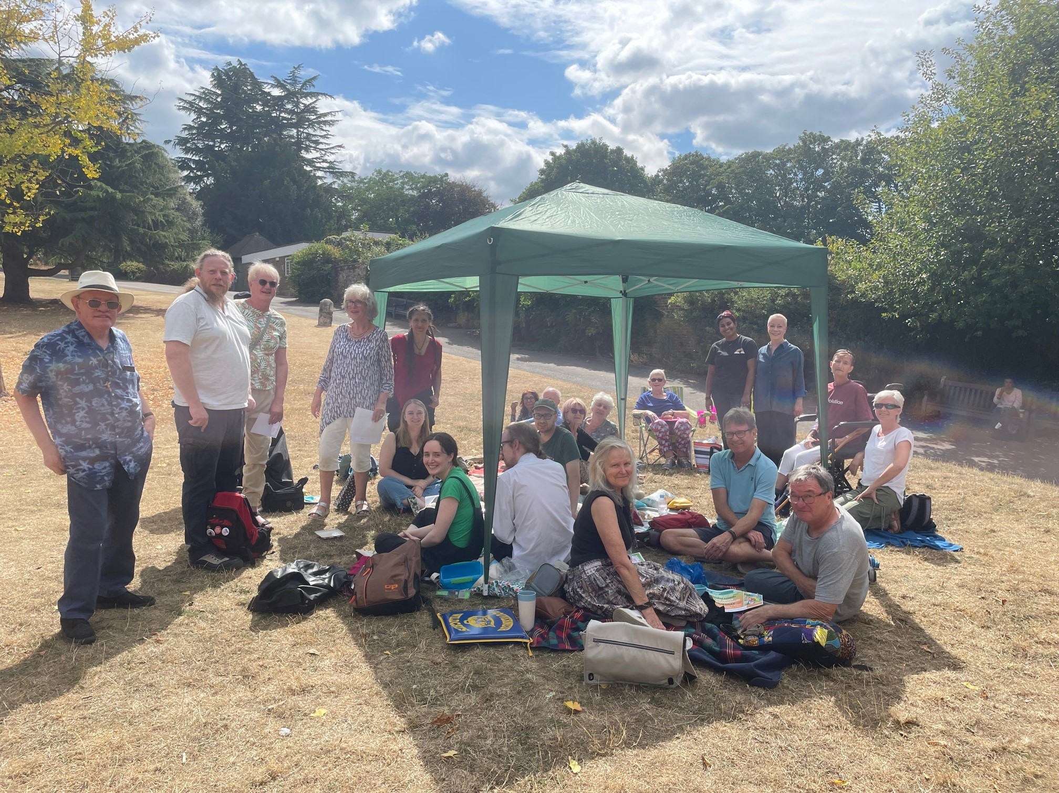
Picnic!

Slide 4
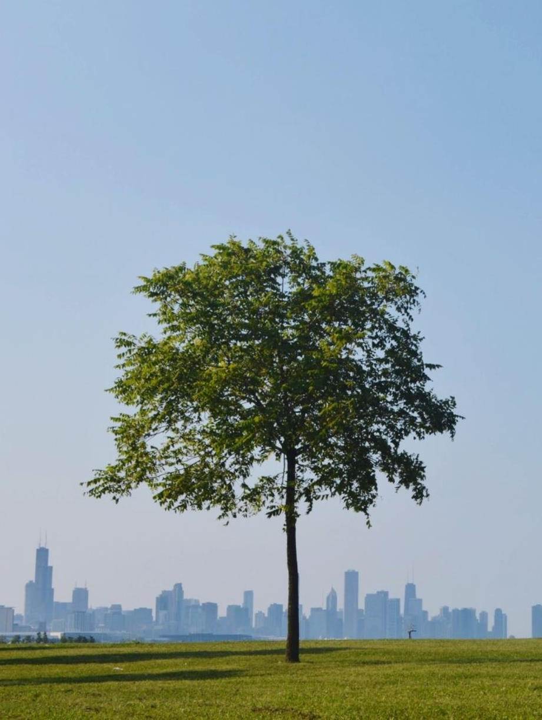
What does Croydon Climate Action stand for?
Working together to build a green and sustainable future for Croydon.
Engaging with the Croydon community in raising awareness of the climate and ecological emergency and leading and supporting on actions that will mitigate its impact.
Working with the local authorities and elected officials to help shape climate-related policy which benefits both the local environment and community.
Leading campaigns, hosting events, workshops and webinars that raise awareness of the climate and ecological emergency and showcase both our group and the community’s efforts to build a green and sustainable future for Croydon.
Actively working on the United Nations’ Sustainable Development Goals, upholding the UN Declaration of Human Rights and the Rights of the Child.
Notes:
Madeleine Cuff (newsletter@news.inews.co.uk)
happyeconews.com

Slide 5
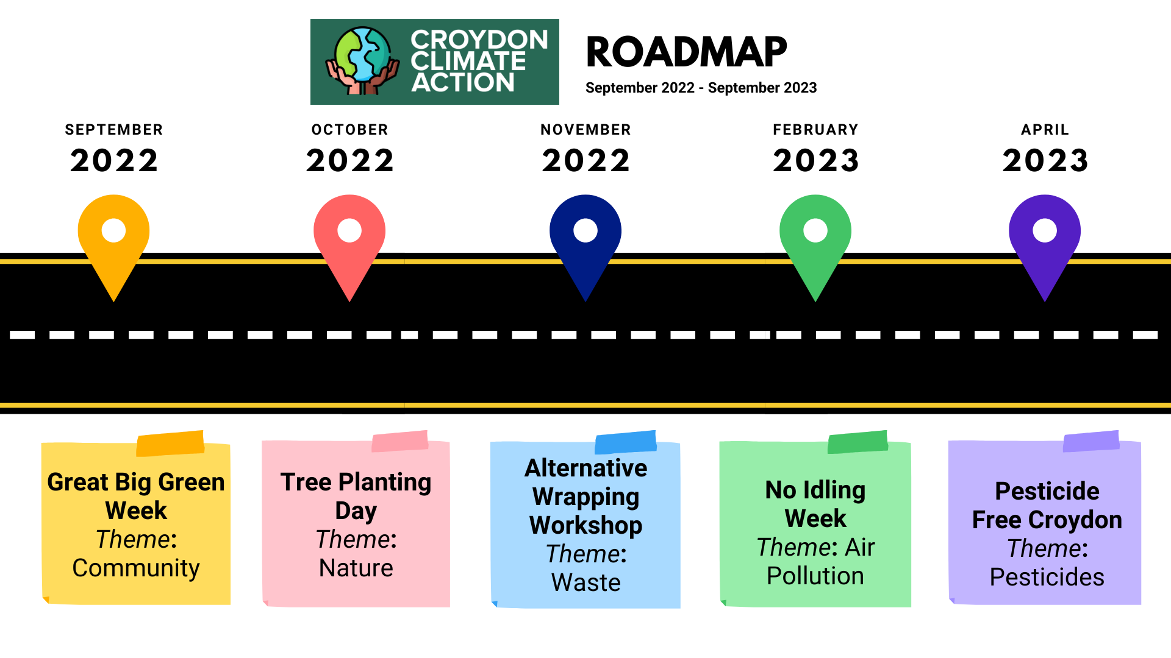
CCA 2022-2023 Roadmap
Notes:
Madeleine Cuff (newsletter@news.inews.co.uk)
happyeconews.com

Slide 6
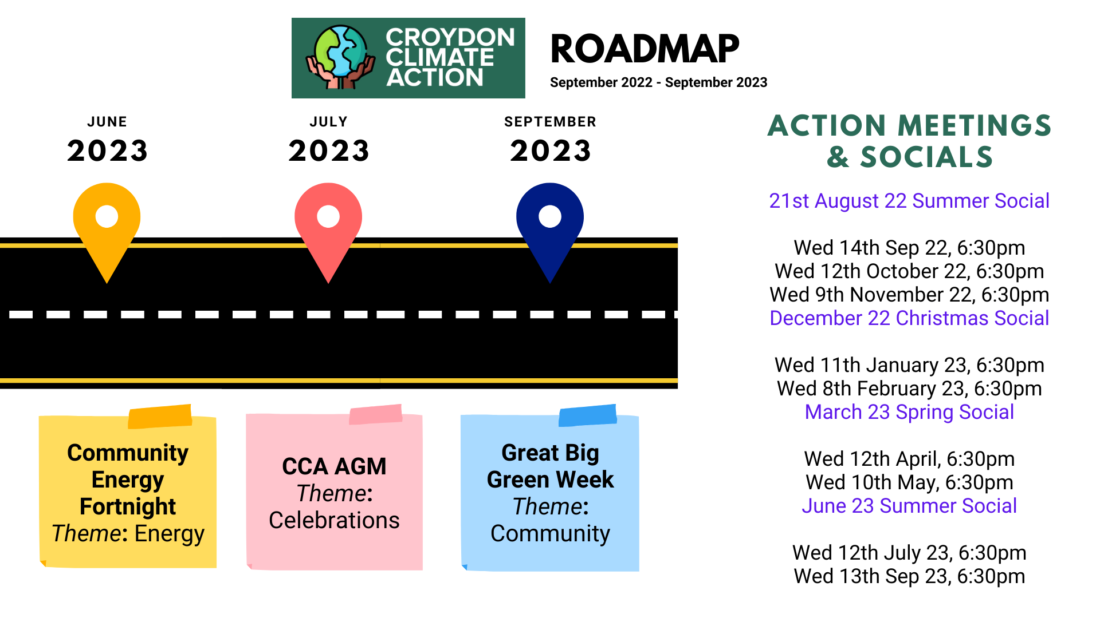
CCA 2022-2023 Roadmap
Notes:
Madeleine Cuff (newsletter@news.inews.co.uk)
happyeconews.com

Slide 7

Great Big Green Week - 24 Sept - 2nd October
Croydon Goes Wild Exhibition

Slide 8

Great Big Green Week - 24 Sept - 2nd October

Slide 9
Great Big Green Week - 24 Sept - 2nd October
CCA Members Pete and Sheila have invited members who are interested in finding out more about reducing their carbon footprint to visit their home.
They can show how they generate and save electricity, heat water etc.
Visits will be arranged for November so if you are interested send your expression of interest to croydonclimateaction@gmail.com and put Carbon Neutral Living in the subject box.
Carbon Neutral Living Event

Slide 10

Walk2COP27
Objectives
Learning, Solidarity, Connections
The 4 outcomes we seek from climate action
Decarbonisation/ Resilience/ Justice/ Circularity
4 Pillars of (mass) participation and engagement
Walk/ talk/ run/ travel in a wheelchair
Townhalls
Clubhouse sessions
Social media
Actions for CCA members
1/ Register: https://www.walk2cop27.com/register-now and join team: CroydonClimateAction
2/ London townhall attendance 26/09: https://www.walk2cop27.com/thejourney/london
3/ Lead or attend a clubhouse session: https://www.walk2cop27.com/clubhouse
4/ Follow and participate on social media: #walk2cop27

Slide 11
The Big Plastic Count
Here are five things we learned from the Big Plastic Count:
UK households throw away approximately 96 billion pieces of plastic packaging a year
The vast majority of it is food and drink packaging
Just 12% of our household plastic packaging waste is recycled
The rest is burned, landfilled or exported
The majority of plastic we throw away is soft plastic
More info here

Slide 12

Climate Ed opportunity
https://reachvolunteering.org.uk/opp/workshop-facilitator-3

Slide 13
Any Other Business (AOB)
Call out - DO YOU KNOW any accountants that would agree to do our accounts once a year?!
Seeking more support on the steering team

Slide 14
Next meetup:
Wednesday 12th October 2022
18:30 - 19:30
We have a WhatsApp group – join using this link: https://chat.whatsapp.com/DlJKqszwLQb8aPagYzJ9qH

