Slide 1
CCA Action Meeting
Wednesday 11th January 2023
18:30 – 19:30

Slide 2
Agenda
Introduction, apologies & welcome to new members -5 mins
Being the change -Léonie 10 mins
Trees4Croydon -the campaign plan and how you could support it! Léonie and Sam 15 mins
United For Warmer Homes - Connie 15 mins
News and updates from the CCA team and our members! 10 mins
Upcoming events and Meeting Dates CGN meet up

Slide 3
2. Being the change!
We now know that it’s not about winning the argument or shouting the facts louder, but about listening and having two-way conversations that resonate with people’s values and what they care about.’ George Marshall - climateoutreach.org
‘Think about the changes you have made to protect the planet. What inspired you to make these changes -was it people shouting the facts louder, or listening to people who you trusted and respected -or a combination of both?

Slide 4
Trees4Croydon Léonie’s slides to be inserted

Slide 5
United for Warmer Homes

Slide 6
News and Updates

Slide 7
Upcoming events and meetings

Slide 8
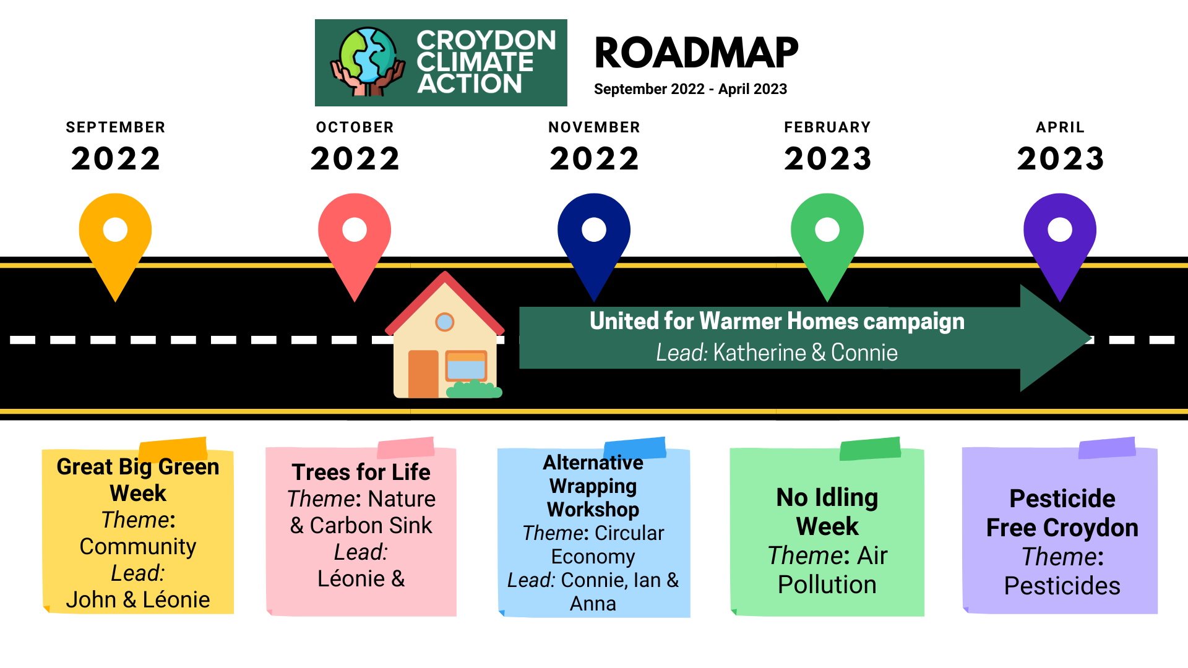
CCA 2022-2023 Roadmap
Notes:
Madeleine Cuff (newsletter@news.inews.co.uk)
happyeconews.com

Slide 9
CCA 2022-2023 Roadmap
Notes:
Madeleine Cuff (newsletter@news.inews.co.uk)
happyeconews.com

