Slide 1
CCA Meetup
Wednesday 9th February 2022
18:30 – 19:30

Slide 2
Housekeeping Rules
Aim for 2 minutes when discussing ideas
Be respectful of everyone
Remain non-party political
Try to stay on topic as much as possible!

Slide 3
Agenda
Welcome (5 mins)
Mayoral Pledge & hustings (30 mins)
Clean Air for Kids (5 mins)
Feed Our Future (5 mins)
Theatre workshop (5 mins)
AOB

Slide 4
Welcome!
Discussion / write in chat:
What positive eco-news have you discovered this month?
Notes:
224 new species discovered in the Greater Mekong region. According to the WWF, 224 plant and vertebrate animal species were discovered in Cambodia, Lao PDR, Myanmar, Thailand, and Viet Nam in 2020. These findings include 155 plants, 16 fish, 17 amphibians, 35 reptiles. The discoveries are a collaboration of hundreds of scientists, NGOs and various research and academic institutions around the world.
The German city of Freiburg is close to becoming climate neutral. Known as the “Green City”, Freiburg is a big promoter of solar energy, with stadiums, churches, and buildings running on solar power. One in three of their residents use bicycles as their main source of transportation. Everything is connected and accessible by streetcars.
Finally, some good news from close to home: Croydon Climate Crisis Commission Report recommended the appointment of a senior level resilience officer with cross Council responsibility for overseeing the implementation of its recommendations! The council have responded positively and Nick Hubbard has just been appointed appointed as Croydon’s corporate Director of Sustainable Communities,Regeneration and Economic recovery!

Slide 5
Croydon Mayoral Climate Action Pledge
To commit Croydon Council to drive rapid reductions in carbon emissions from activities in the borough of Croydon to become carbon neutral by 2030.
To act with urgent pace to fully implement all 23 recommendations of the Croydon Climate Crisis Commission Report.
To commit Croydon Council to the Government’s Clean Air Strategy 2019 to rapidly improve air quality for Croydon.

Slide 6
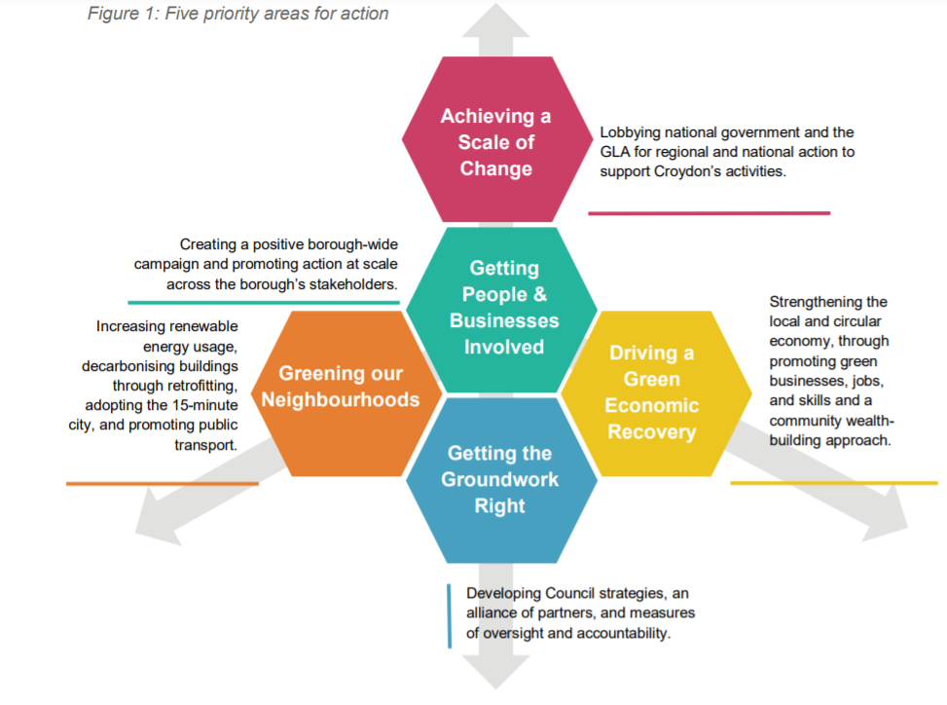
Croydon Climate Crisis Commission Report - Recommendations

Slide 7
Clean Air Strategy 2019
This Clean Air Strategy shows how we will tackle all sources of air pollution, making our air healthier to breathe, protecting nature and boosting the economy. There is the belief that the goals can be reached
It covers
Health,
environment
clean growth and innovation
Reducing emissions from farming,transport, homes, industry
‘Analysis shows that the actions set out in this strategy can meet our ambitious emissions reduction targets, if they are implemented with the necessary pace and determination’

Slide 8
Croydon Mayoral Campaign
Elections 5 May 2022 for Mayor and 70 ward councillors to Croydon Council!
Next steps:
Publish the Croydon Climate Action Pledge for Mayoral candidates - and councilors - as widely as possible on social media etc
Invite Mayoral candidates and councillors to sign up to the Pledge.
Organise climate action hustings with all Mayoral candidates- face to face on zoom and through schools and colleges in Croydon.
CCA Members’ Actions - can you spread the pledge -publicise hustings- submit questions for hustings?

Slide 9
Clean Air For Kids Campaign
Breathe London Bid -successful!!
The aim of the Breathe Croydon project is to:
Educate a school community about the impact of NO2 emissions and particulates on the health (both long and short term) of children and young people.
Take action to reduce their children’s exposure to air pollution including measures set out in the Breathe London Wearables study.
Hold the communities elected representatives (Mayor, Councilors, MPs GLA representatives) and the polluters to account on reducing air pollution in their locality.
Notes:
We have selected a school next to busy main road where traffic queues at lights. The school is in the north of the borough in an area of deprivation with a deficit of green space.

Slide 10
Clean Air for Kids - next steps!
Re-start Idling Action Croydon that was suspended due to covid restrictions. This is part of a London wide behaviour change campaign aimed at reducing localised air pollution caused by motorists leaving their engines running when parked.
https://idlingaction.london
Viridor Incinerator Beddington Campaign
CCA Members’ Actions -
If you have links with schools and if appropriate could you engage them in the Idling Action Croydon Campaign?
Would you like to be involved in the incinerator campaign? Can you offer any expertise knowledge to this? Suggestions for title for campaign?

Slide 11
Croydon Youth Theatre Organisation
Croydon Youth Theatre Organisation are looking for a diverse group of Croydon Community members aged 60-80 years old to get involved in our next play 'Superglue' by Tim Crouch. The play is about climate change and activism.
No acting experience necessary. Performances at The Shoestring Theatre and Southwark Playhouse in March and April.
Please email andrewmcpherson@cyto.org.uk for more information and a sign-up form.

Slide 12
Croydon Youth Theatre Organisation
We have been asked to run a two hour workshop with the younger cast on Saturday 19th February between 2-4pm.
Some of the things we want the cast to unpack are:
What is it that climate activists are fighting for?
What motivates activists?
The difference between violent and non-violent activism?
What's going to happen if nothing changes?
And what are some of the things they could be doing to help protect the planet?
CCA Members’ Actions: Is anyone free and willing to help Connie & Anna run the workshop?

Slide 13
Feed Our Future
The campaign is back up and running, being run by Alex Jamieson!
We are asking Croydon Council to encourage and work with schools to move to plant-based menus, and serve plant-based meals at Council meetings.
Alex has prepared a whole presentation too which you can see here, Connie has added a couple of the main slides in this presentation.

Slide 14
Councils and Schools
Many of us will have seen they recent film “Don’t Look Up”
It isn’t a comet heading for us, but a climate emergency, and it is already here.
We still have a few years to work together to deal with enormity of the problems we face as a community, country, and planet.
So how do we find impactful, measurable solutions to our most pressing climate, health and environmental problems whilst upholding our ethical obligation to protect animals and biodiversity?

Slide 15
The Answer is Plants
Simply including more healthy plant based options on the school menu, and switching to plant based for council events has an immediate positive impact.
It massively reduces the council’s carbon footprint, improves the availability of fruit and veg for the 82% of UK children who don’t get their 5 a day, with more fibre and plant based food reducing the risk of childhood obesity and other diseases.
Enfield, Leeds and Lewisham councils have made the switch. Our council needs to move next, so please sign the petition and let your MP know your thoughts- if enough of us demand this, we will make a huge difference. Thank you!
CCA Members’ Actions: please sign the petition -you can find it here. If you have links with schools you could find out if they would be interested in joining the campaign.
Notes:
Alex is happy to share my email with anyone who would like more information

Slide 16
Any Other Business (AOB)
CCA Spring social in-person event! What do you think?
Thoughts on setting up a virtual eco-book club?
First Sustainable Thornton Heath Hub is on 26th March 1-4pm in the Salvation Army hall.
Friends of Park Hill Park are looking for more volunteers to help with their walled garden, let us know if you can help.

Slide 17
Next meetup:
Wednesday 9th March 2022
18:30 - 19:30
We have a WhatsApp group – join using this link: https://chat.whatsapp.com/DlJKqszwLQb8aPagYzJ9qH

