Slide 1
CCA Meetup
Wednesday 14th April 2021
18:30 – 19:30

Slide 2
Agenda
Update on Mayoral campaign
Hustings info and questions
Green New Deal
Feed our Future campaign
Earth Day - 22nd April 2021
Pesticide Action Network
Any other business

Slide 3
Update on Mayoral Campaign
Since last meeting…
Organised and started advertising the hustings event next week
Got Patsy Cummings (Labour) and Neil Garratt (Conservative) to agree to come to the hustings
Article published on Inside Croydon here
Created an infographic about the elections to send to schools (see next slide)

Slide 4
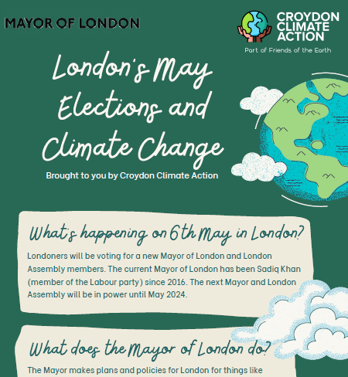
Let us know if you want a copy of the PDF to send to any schools you have links with!
Doc can be found here.

Slide 5
Hustings - 21st April 2021
All 4 candidates attending!
Do you have any questions you wanted to add? Bear in mind we only have 1 hour!

Slide 6
Green New Deal UK
A non-profit group working to implement a Green New Deal in the UK that comprises “decent housing, well-paid and secure jobs, and an environment that doesn’t make us sick”.
Change the way we think about green jobs:
What are Green Jobs? Green jobs are low carbon jobs, or jobs that help us move to a post-carbon economy. Alongside jobs in renewable energy or insulating homes, planting trees or restoring habitats jobs in caring sectors like health, childcare and education, as well as jobs in low carbon forms of farming, are green jobs.

Slide 7
Green New Deal UK - Report
Just released data about how many green jobs can be created in Croydon
Data is embargoed until 19th April at 10:30pm
In summary, 4,301 short-term jobs and 10,379 long-term jobs
They want us to take action locally to:
Put pressure on MPs to provide Green Jobs for people in their constituencies
Show your community the potential for green jobs locally and build the strength of voices demanding them
Help people understand what a Green New Deal is by providing a tangible example of what it means for people’s lives

Slide 8
What are CCA doing about this?
We will be sending out a press release to highlight these potential jobs and get people talking
Pressure Croydon MPs to commit to signing the Early Day Motion (EDM) in parliament on green jobs for the week of 19th April
Action Day on Saturday 24th April
Socially-distanced queues of up to 6 people across the country to represent people queuing up for green jobs
Creating queues of lego people/cardboard people
Do you want to get involved?

Slide 9
Feed Our Future Campaign
Getting more plant-based options in our schools would help the climate, children’s health and save the council money!
Connie, Katherine and Alex (CCA member) have met with ProVeg and attended a talk by Animal Rebellion
In Leeds, the council has introduced more plant-based and veggie options to over 180 schools
Petition and launch a campaign (Feed our Future, name TBC) - who would be interested?

Slide 10
Earth Day 2021
Earth Day is an annual event on 22nd April to demonstrate support for environmental protection.
Ideas for children:
Blue Peter Green badge - three Power, Plastic and Plants Pledges for at least two weeks - claim here
Friends of the Earth HQ have Planet Protector packs for children, in exchange for a donation - order here
Any other ideas we could do on the day?

Slide 11
Pesticide Action Network
Across London, pesticides are still being sprayed in parks, playgrounds, pavements, schools and other public spaces. Many of these pesticides have been linked to serious health problems and contribute to biodiversity decline.
More than a third of London boroughs have ended, or significantly reduced, their pesticide use.
By getting people to send an email to candidates and creating a buzz on social media we’re hoping to use the mayoral elections as an opportunity to make all of London pesticide-free!
https://www.pan-uk.org/pesticide-free-elections-london/

Slide 12
Any other business?

Slide 13
Don’t forget to register for the hustings!
https://actionnetwork.org/events/croydon-sutton-london-assembly-elections-hustings-2/
Next meetup:
Wednesday 12th May
18:30 - 19:30

