Slide 1
CCA Meetup
Wednesday 13th April 2022
18:30 – 19:30

Slide 2
Housekeeping Rules
Aim for 2 minutes when discussing ideas
Be respectful of everyone
Remain non-partisan
Try to stay on topic as much as possible!

Slide 3
Agenda
Welcome (5 mins)
Mayoral Pledge & hustings questions - Katherine (30 mins)
Great Homes Upgrade - Léonie (5 mins)
The Big Plastic Count - Connie (5 mins)
Upcoming events (5 mins)
AOB

Slide 4
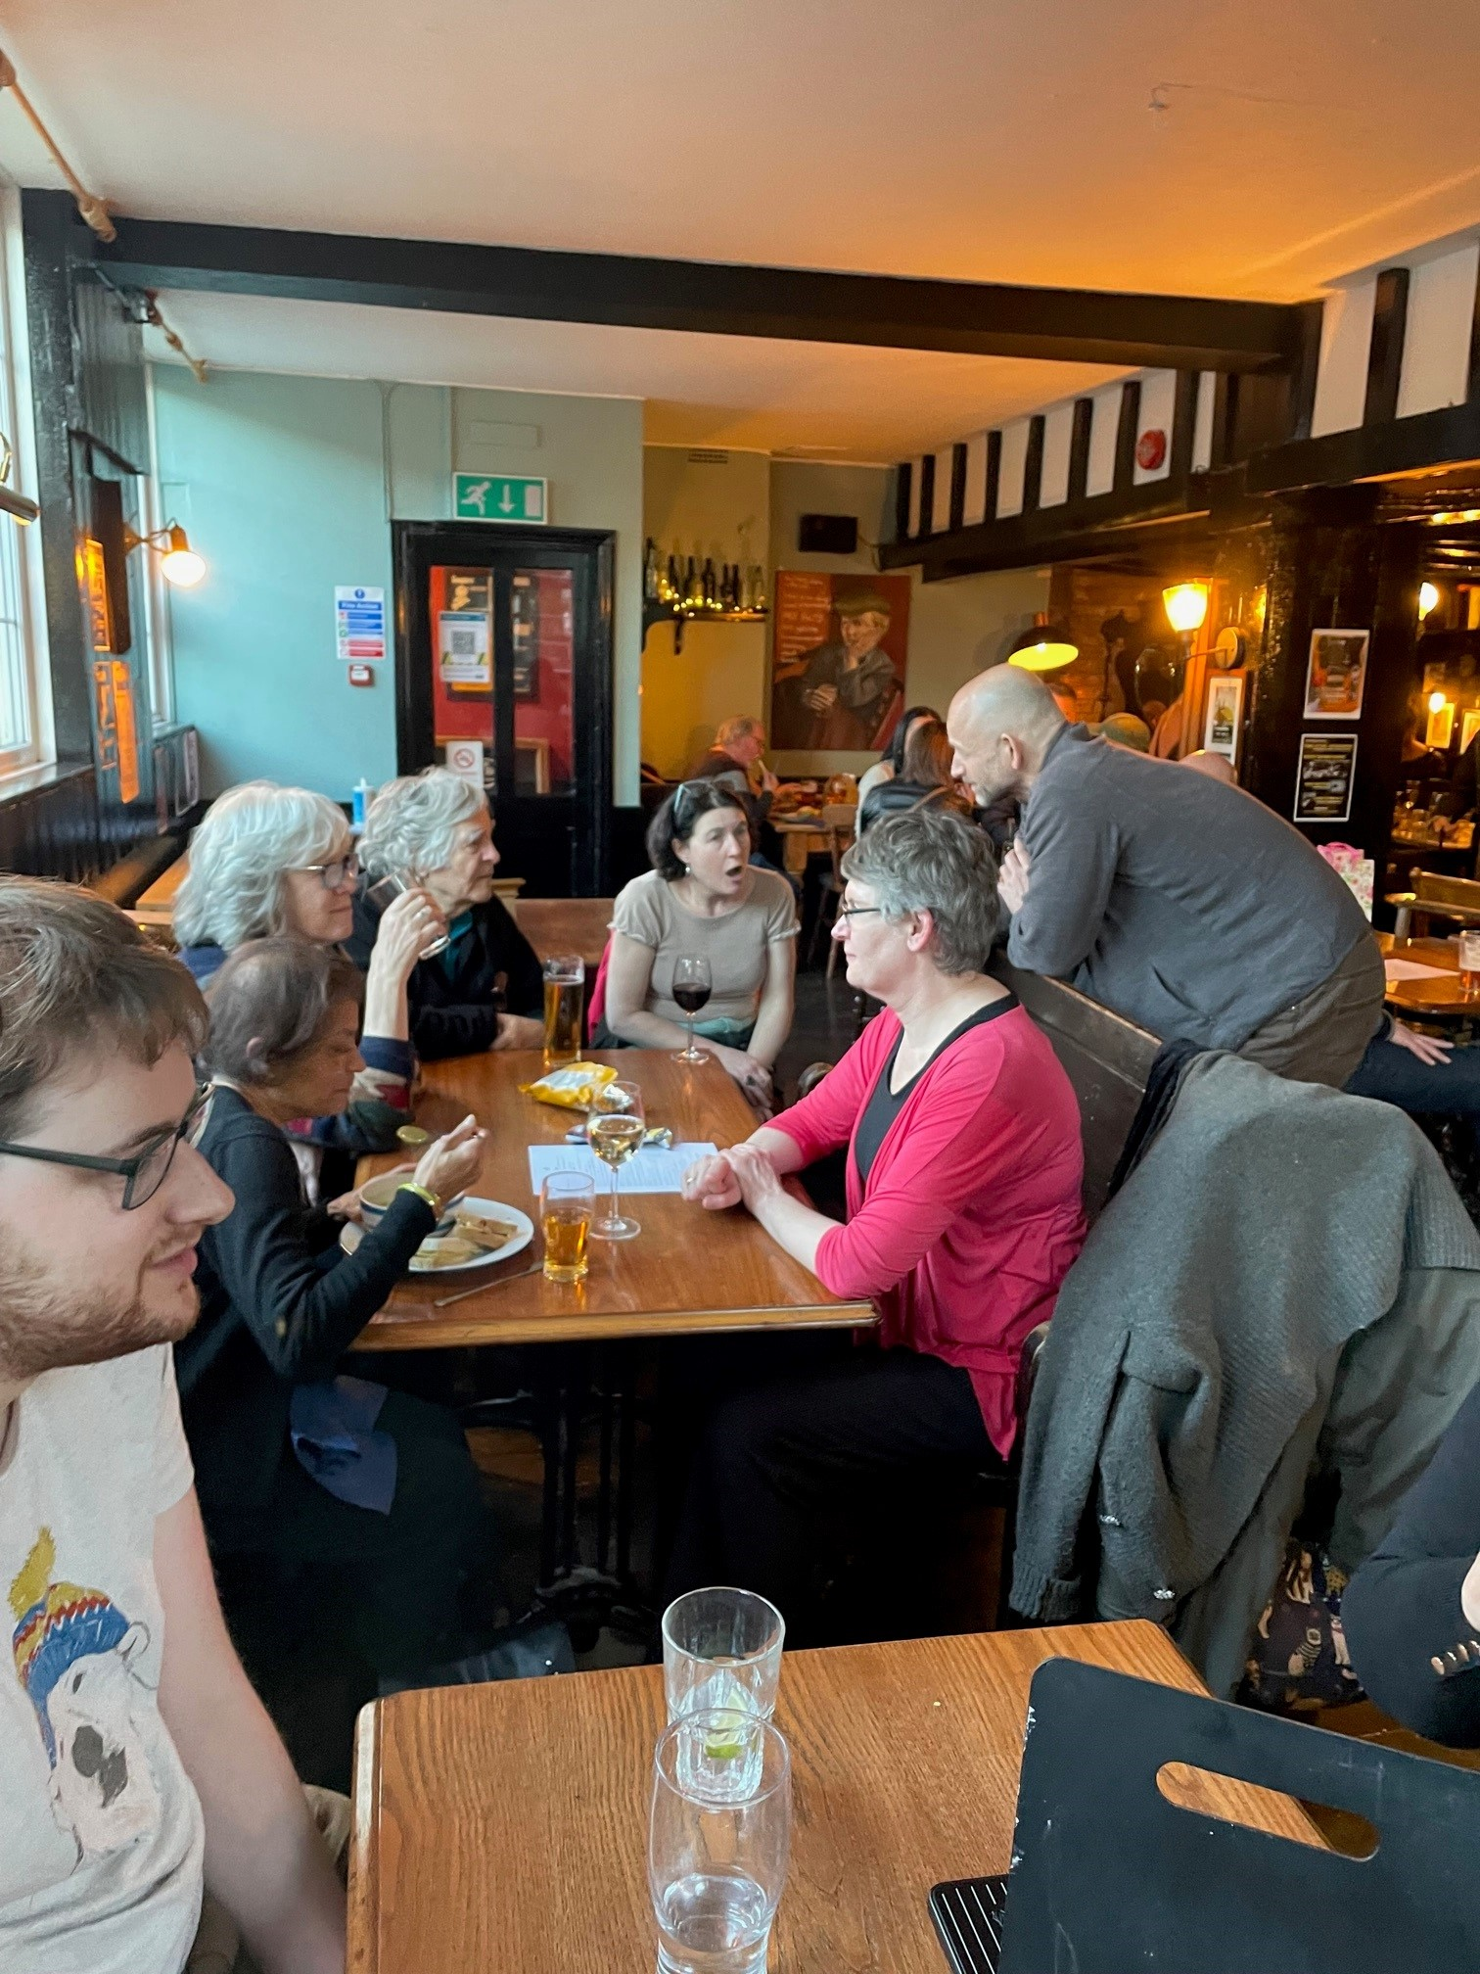
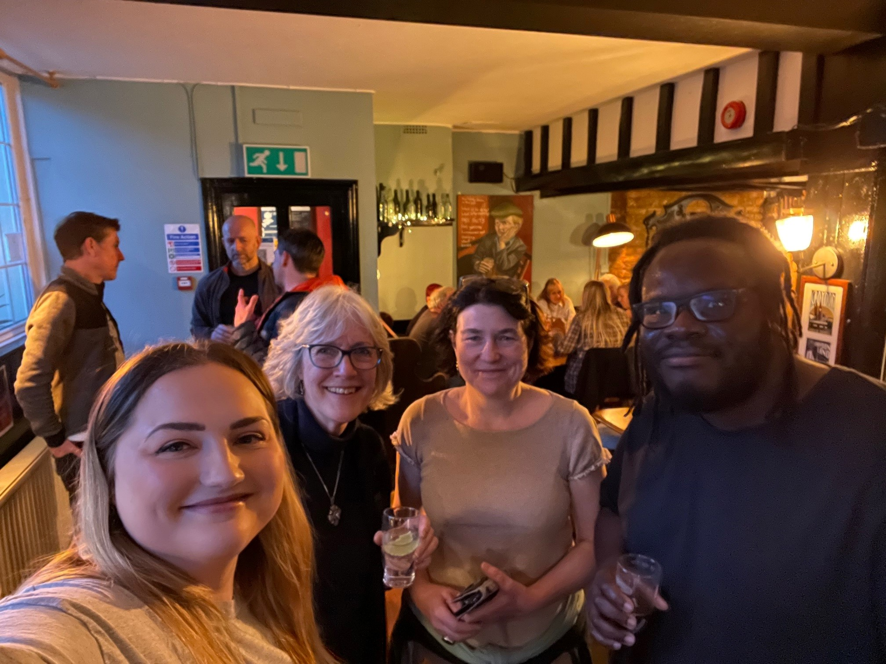
CCA Social Photos
Notes:
Madeleine Cuff (newsletter@news.inews.co.uk)
happyeconews.com

Slide 5
Welcome!
Discussion / write in chat:
What positive eco-news have you discovered this month?
Notes:
Madeleine Cuff (newsletter@news.inews.co.uk)
happyeconews.com

Slide 6
Croydon Mayor’s Climate Crisis Pledge
Updates on sign ups to pledge -
6 Mayoral candidates
13 Councillor candidates
CCA Members’ Actions
Contact the Councillors standing in your ward and ask them to support the pledge
Notes:
Katherine can you explain how members can easily contact their councillors?

Slide 7
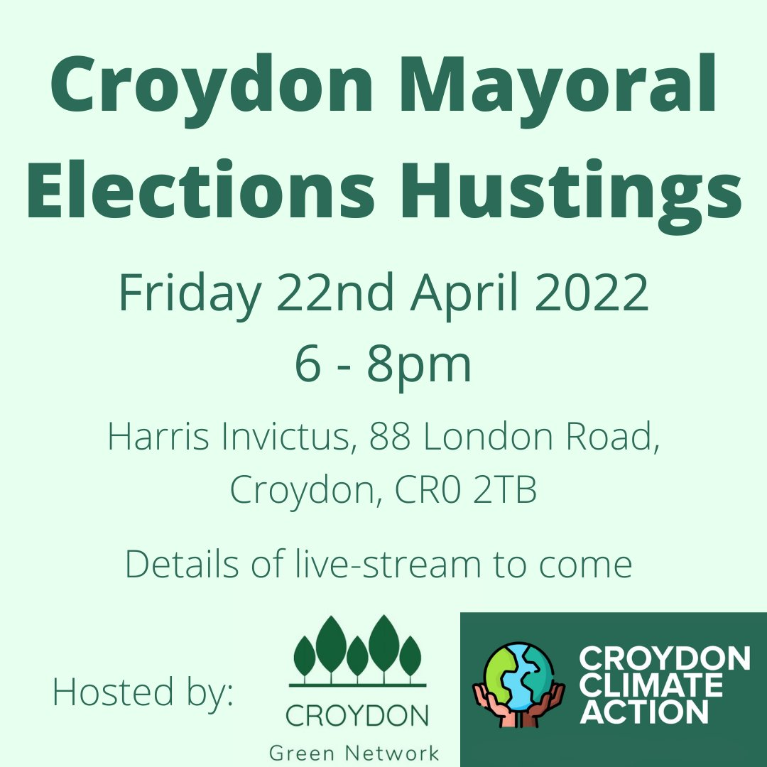
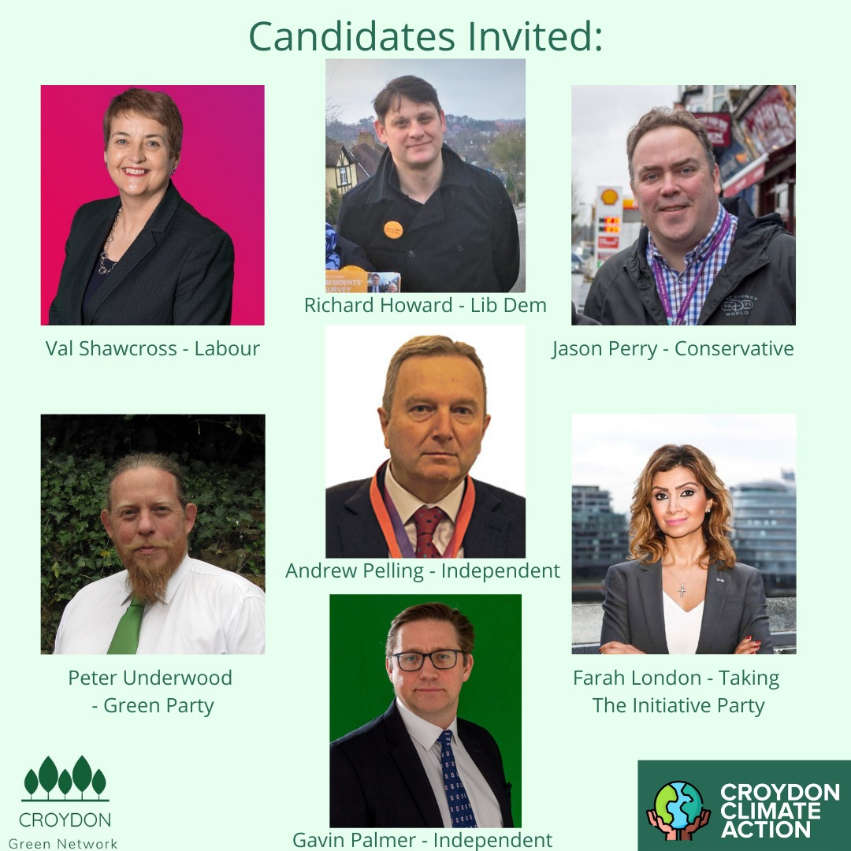
Croydon Mayoral Hustings
Notes:
Katherine can you explain how members can easily contact their councillors?

Slide 8
Croydon Mayoral Hustings Agenda
17:40 - doors open
18:00 - introductions & housekeeping → talk about CCCC report and our pledge, explaining the basis for the questions
18:15 - candidates opening remarks (2 minute each)
18:30 - pre-prepared questions from group
19:15 - questions open to floor
19:45 - closing remarks from candidates (2 minutes each)
20:00 - end
Notes:
Katherine can you explain how members can easily contact their councillors?

Slide 9
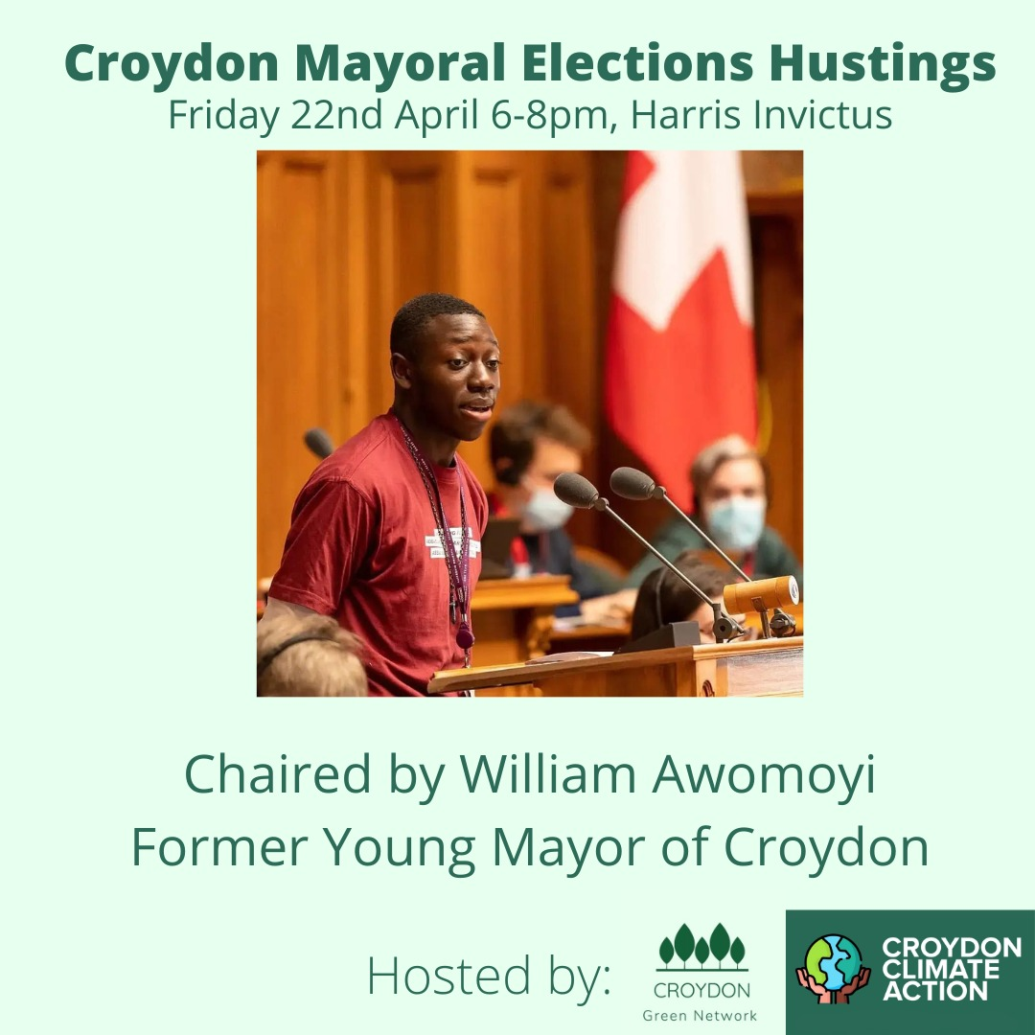
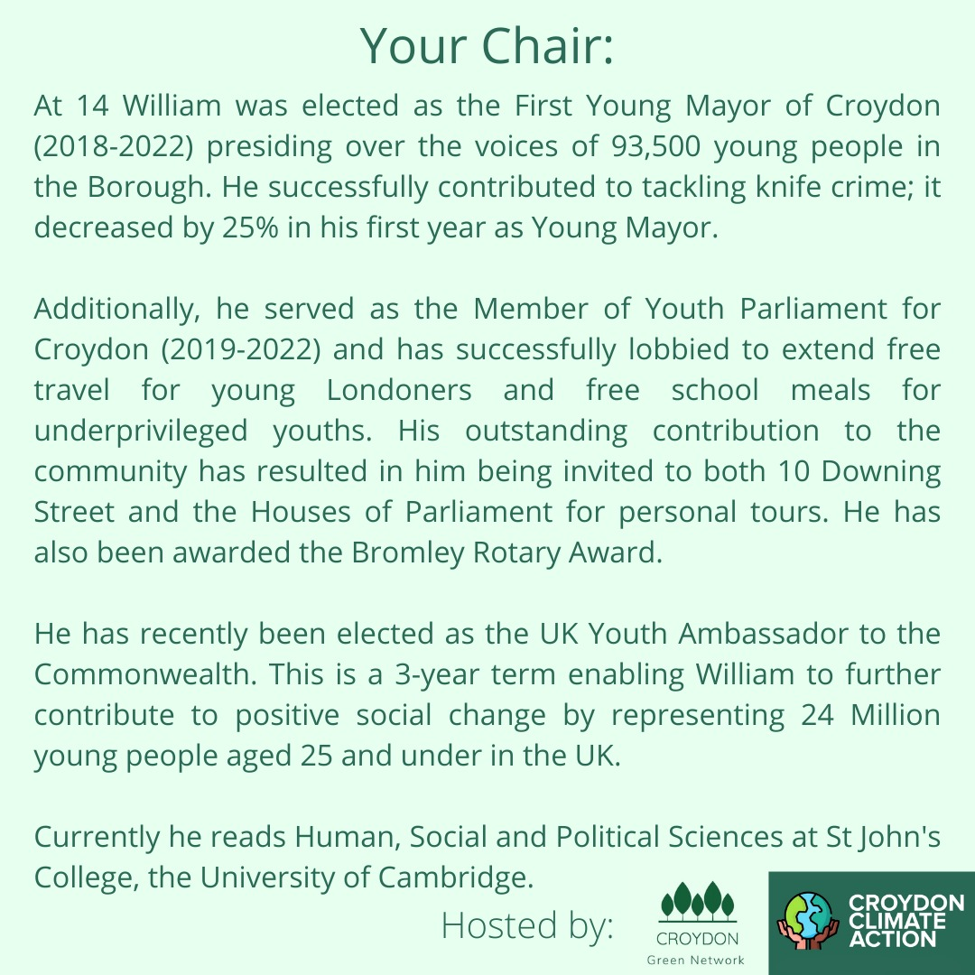
Croydon Mayoral Hustings
Notes:
Katherine can you explain how members can easily contact their councillors?

Slide 10
Notes:
Katherine can you explain how members can easily contact their councillors?

Slide 11
Ideas for question themes:
Protecting our most vulnerable from the effects of climate change.
Ensuring new builds are well insulated and have eco-aware fittings.
Increasing and improving public transportation provisions.
Enabling and supporting the use of renewable energy.
Promoting sustainable consumption in order to to become a zero-waste area
Ensuring everyone has access to green spaces.
Brainstorm - what can we ask?
Notes:
Katherine can you explain how members can easily contact their councillors?

Slide 12
FoE Election Asks
1. Accelerate the rapid escalation of retrofitting buildings across the borough, to provide warm, low-carbon homes and workplaces for all, and tackle fuel poverty
2. Rapidly create the green jobs needed to bring down emissions across all sectors, and provide the necessary skills training to meet this goal
3. Ensure most journeys in the borough are taken by walking, cycling and public transport by:
4. Reallocating road space as public space across the borough for walking, cycling, parklets and green spaces
5. Giving buses more priority on roads controlled by the borough
6. Protect existing green spaces and create new nature rich areas especially where people have less access to nature
7. Engage local communities - and especially those most vulnerable to climate change impacts - in decision making around action for climate and nature
Notes:
We’ll add this to our website on questions page

Slide 13
TO REGISTER TO ATTEND THE HUSTINGS
In person: https://actionnetwork.org/events/croydon-mayoral-hustings
Virtually: https://www.croydonclimateaction.com/event-details/croydon-green-network-hustings-virtual-audience
Notes:
Katherine can you explain how members can easily contact their councillors?

Slide 14
Great Homes Upgrade
There is no route to decarbonising the economy without retrofitting millions of homes!
Did you know that:
£1 in every £4 spent on energy is wasted!
780,000 children live in damp homes!
Housing produces 14% of carbon emissions!
Upgrading our homes will:
Eradicate damp
Save families millions
Power our homes with clean energy
You can:
Email your MP
Join the campaign
Download the toolkit for further information and support here - https://greathomesupgrade.org
Notes:
Katherine can you explain how members can easily contact their councillors?

Slide 15
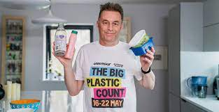
The Big Plastic Count
Count your plastic for one week – 16-22 May 2022.
Across the country, households of all shapes and sizes, schools, community groups and businesses, will gather new evidence. How much plastic are we really having to throw away, and what happens to it?
We’ll show the government it’s time to commit: reduce single plastic use by 50% by 2025 by switching to reusable options that work for everyone – and ban sending our waste to other countries.
Sign up here: https://thebigplasticcount.com/sign-up
Notes:
Katherine can you explain how members can easily contact their councillors?

Slide 16
Upcoming Events
Broad Green in Bloom
See poster on right
Sustainable Thornton Heath hub
Monthly event for sustainable living incl. Repair café, plant-based food tasting, workshops and more. 4th Saturday of the month - next one 23rd April @ 1-4pm, Thornton Heath Salvation Army. No RSVP needed.
Friends of the Earth Groundswell Event Sat 25th June 10-5pm £10 tickets https://www.eventbrite.co.uk/e/groundswell-london-south-east-2022-tickets-290405569877 (let us know if you come as we will go together!)

Slide 17
Upcoming Events
Sustainable Coulsdon Eco Fair III
10am - 4pm, Sunday 24th April, St John's Parish Hall, Marlpit Lane CR5 1ED, Old Coulsdon
Facebook event details here: https://fb.me/e/1l0VAQDkC
Textile Repair Cafe event
11am - 3pm, Saturday 30th April, Whitgift Centre

Slide 18
Any Other Business (AOB)
London FoE Network update - Connie

Slide 19
Next meetup:
Wednesday 11th May 2022
18:30 - 19:30
We have a WhatsApp group – join using this link: https://chat.whatsapp.com/DlJKqszwLQb8aPagYzJ9qH

