Slide 1

CCA Meetup
Wednesday 12th January 2022
18:30 – 19:30

Slide 2
Housekeeping Rules
Aim for 2 minutes when discussing ideas
Be respectful of everyone
Remain non-party political
Try to stay on topic as much as possible!

Slide 3
Agenda
Welcome (5 mins)
What is CCA’s vision? (10 mins)
Croydon Mayoral Campaign (15 mins)
Clean Air for Kids Campaign (10 mins)
Croydon Community Energy update (5 mins)
Sustainable Thornton Heath Hub (5 mins)
AOB

Slide 4
Welcome & Happy New Year!
Discussion / write in chat:
Do you have any links we might work with e.g. faith groups, businesses -private and public sector, schools, charities etc?

Slide 5
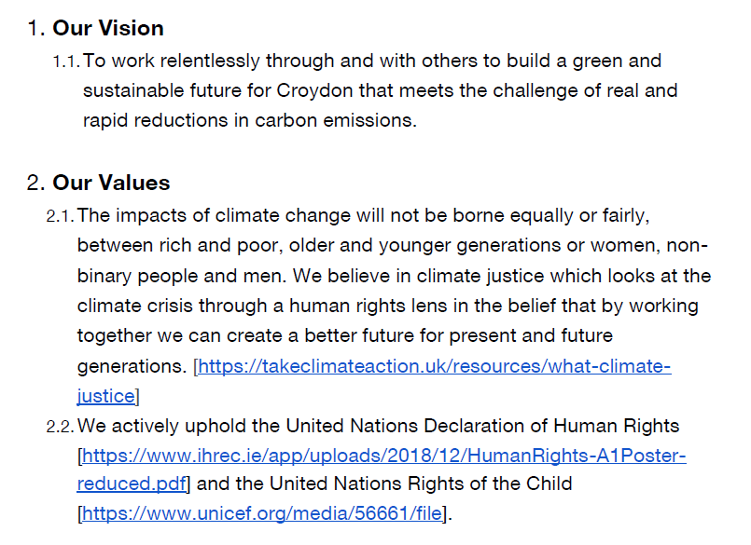
CCA’s Vision & Values
We have now written a constitution, which will be published on the website soon.

Slide 6
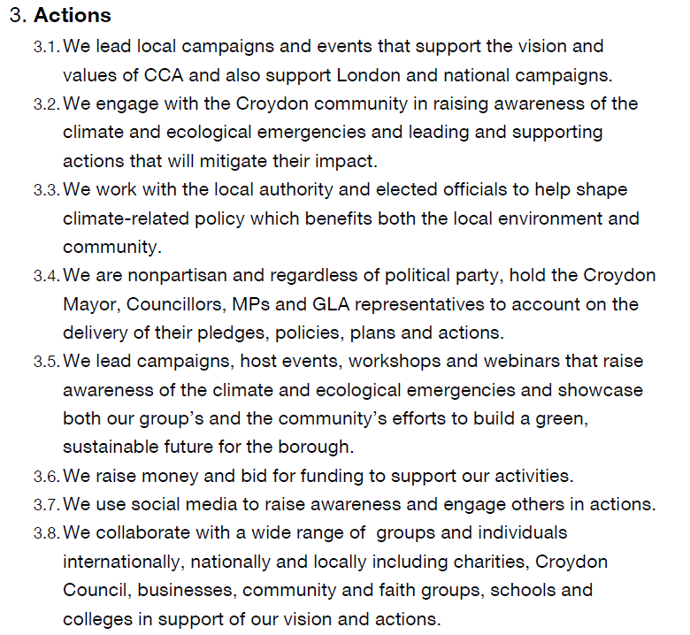

Slide 7
What does Croydon Climate Action stand for?
Our CCA Vision - Real and rapid reductions in carbon emissions - why?
We refer to real and rapid emissions reductions rather than Net Zero or offsets - Net zero is controversial, but really what’s important is the pathway. There must be real emission reductions to as close to zero as possible as quickly as possible. Anything other than that shifts burden of emissions reductions elsewhere, or distracts from making real emissions cuts. Things like CCS, offsetting, nature based solutions, geoengineering etc. can distract from real emissions cuts and create massive environmental and human rights dangers.
Our CCA Values - we believe in Climate Justice (link to presentation here)
We need to look through a climate justice lens at the kinds of things we’re campaigning on. We can do this by asking ourselves some key questions...
How might the changes in what we’re campaigning for, impact on Black, brown and ethnic minority people? On people on low incomes or in poorer communities? On LGBTQ+ people? On disabled people? What will the impact of the change be further afield? Is there anything we’re not considering? How can we make sure all people are impacted positively and that we mitigate any unintended consequences?
Let’s look through this lens at the Mayoral pledge and the Clean Air for Kids Campaign to follow.
Looking for ways climate justice appears in our communities
Adding a social justice lens to our campaigns

Slide 8
Croydon Mayoral Campaign
Held a very successful and collaborative workshop on 1st December 2021 and began to form our pledge for Mayoral candidates and councillors.
Marcus has synthesised these into a Croydon Mayoral Pledge document for review.

Slide 9
Croydon Mayoral Campaign
We ask all Croydon Mayoral candidates to commit to the following measures:
On taking office:
Commit the council to implementing all 23 Recommendations of the March 2021 Croydon Climate Crisis Commission Report and communicate progress at least annually.
Commit to working relentlessly to seek out ways and opportunities to reduce emissions and environmental impacts.
Instigate a full audit of Councillors’ and senior officers’ skills and knowledge relevant to the climate emergency and the above commitments to take place within the first year, to be followed with a plan to fill any identified gaps.

Slide 10
Croydon Mayoral Campaign
Within the first term, use the power and public profile of the Mayor to develop, promote or support policies or programmes to:
4. Protect, promote and increase tree cover and greenspace on council land and use tax and planning measures to incentivise the same on private land.
This would be demonstrated by:
Mature, healthy trees and woodland protected from development
Unused green spaces such as verges, roundabouts and the boundaries of council-managed sports pitches left to grow wild; the reasons publicised and and signs and boundary markings used as necessary
A significant area of each public park reserved as a demarcated wildlife habitat
Neighbouring green spaces linked by safe wildlife pathways
Disincentives in the planning process or local tax regime leading to a reduced number of paved over gardens or other green space

Slide 11
Croydon Mayoral Campaign
5. Monitor, report on and take action against breaches of environmental obligations
Air pollution levels measured hourly at sites across the borough and published in real time if possible, otherwise within days
Environmental clauses included in all supplier contracts
Monitoring, publication and enforcement action taken against breaches of contracts by council suppliers or planning rules and legislation by any company or organisation in the borough which increase pollution, energy use or waste or otherwise have a harmful environmental effect
20mph speed limits visibly enforced where they are in place and the number of speeding fines in these locations published
The climate impact of all proposed council policies is analysed and published before their adoption

Slide 12
Croydon Mayoral Campaign
6. Promote sustainability through local schools
Encouraging Croydon schools to become Eco Schools and STARs schools
Challenges set and awards given for school environmental activity
7. Use Council resources and Croydon’s position as London Borough of Culture 2023 to support and publicise local sustainability projects
A borough-wide green composting scheme available to all residents
Community gardening and farmers’ markets publicised using council channels
Community-managed sustainable services used and promoted by the council

Slide 13
Croydon Mayoral Campaign
Any comments?
  One comment was to ask for a commitment to implement the Council's cycling strategy 2018-23.
  Croydon Living Streets’ Manifesto would also be good to draw from. Their main points include clear footways, slower car speeds, road user charging, LTNs and fairer parking. It is still a confidential draft, let us know if you want to see the full version.

Slide 14
Croydon Mayoral Campaign
Next steps
  What do we do if a candidate doesn’t want to take the pledge, or only accepts some of it?
  Publish the pledge and write to candidates
  Organise hustings

Slide 15
Clean Air for Kids Campaign
No Idling London Campaign - https://idlingaction.london/schools/
Introduces the importance of clean air
Explains the main pollutants and their sources in London
Demonstrates the invisible threat of pollution in real-time using citizen science PM monitoring
Connects pollution exposure with health conditions in young Londoners
Gets students to think about their own journeys and the pollution they might encounter
Centralises idling action as the best way of empowering young people to enact positive change and to address easily preventable pollution
Engages pupils and students in action!
How can you help? We need contacts with schools -young people, parents, school staff….. Please email Léonie at croydonclimateaction@gmail.com or direct message on out whatsapp group -thank you

Slide 16
Croydon Community Energy Update
CCE was set up to implement community-owned energy generation projects and try to reduce carbon emissions in Croydon.
Before Christmas, applied for the London Community Energy Fund with 3 sites in mind.
Unofficially been offered half of the money applied for - currently working out which site(s) we should prioritise.
More info about the group on the website: https://www.croydoncommunityenergy.co.uk/

Slide 17

Sustainable Thornton Heath Hub
What, when and where?
Promotion
Volunteers needed:
  Fixing electronics & electricals
  Leafleting
  Fixing clothes (people need to have be willing to bring their own machine and equipment)
  Refreshment serving (hot drinks)
  Other roles such as cajoling people outside to come in and take a look, feedback gatherers (inc. via video clips), and helping with tables such as kids’ activities and item swaps.
  Communications (including social media) – could be STH MC post.
Workshops / talks / Q&A
Email sustainablethorntonheath@gmail.com for more info!

Slide 18
Any Other Business (AOB)
Change is Here talk by Croydon Living Streets - 24th January at 18:30pm - sign up here.
Climate Ed is a charity that offers free education to children about climate change and climate literacy. They are keen to expand into South London especially Croydon and are looking for new volunteers to deliver workshops in school - apply here.
Newsletter is firing back up again! Please let us know if you would like to contribute.

Slide 19
Next meetup:
Wednesday 9th February 2022
18:30 - 19:30
We have a WhatsApp group – join using this link: https://chat.whatsapp.com/DlJKqszwLQb8aPagYzJ9qH

