Slide 1
CCA Meetup
Wednesday 10th March 2021
18:30 – 19:30

Slide 2
Agenda
Ground Rules & Introductions
About Croydon Climate Action
Campaigns
How to get involved
Hustings
Long-term goals and future campaigns

Slide 3
Ground Rules
Be respectful
No judgement - everyone is at a different point in their climate change journey
Don’t make assumptions about other people's identities and experiences
Do not dominate discussion
Maintain political neutrality - healthy discussion only
Try not to be defensive - listen and learn. Approach discussions with openness and appreciation
The community offers a safe space for its members
Be clear and concise when contributing to discussion
Have fun!

Slide 4
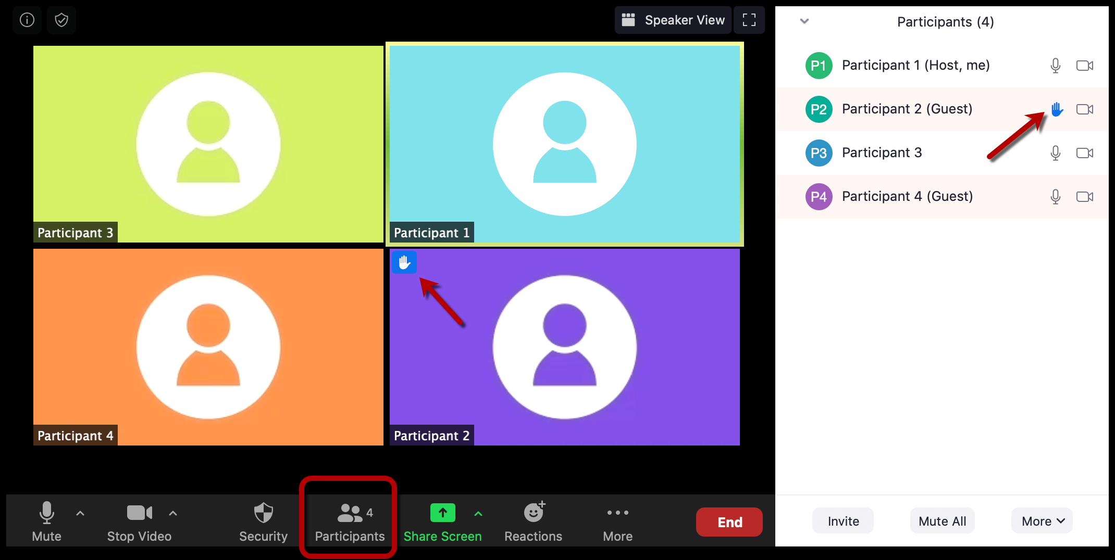
Zoom Etiquette
Please use the “Raise Your Hand” function or write “hat” in the chat box if you wish to speak
Stay on mute when not speaking

Slide 5
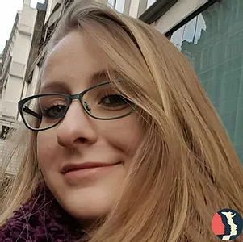
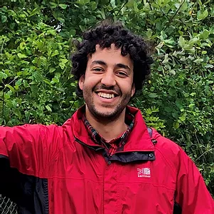
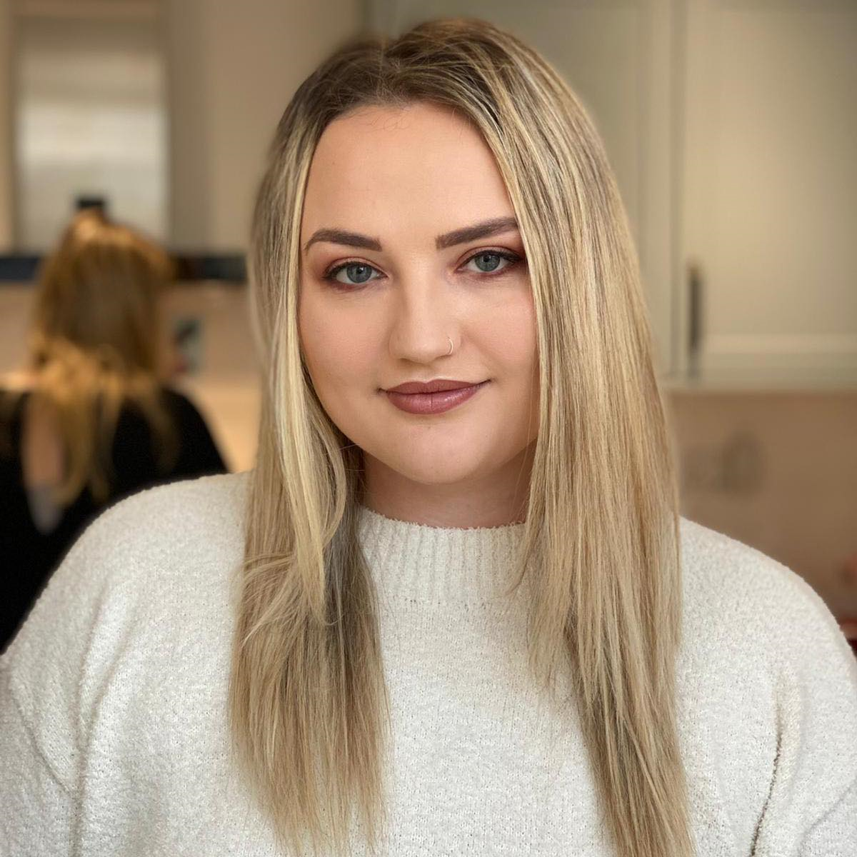
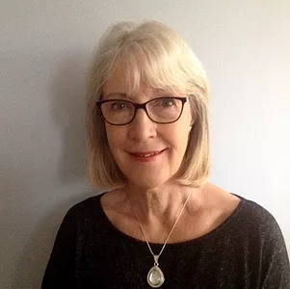
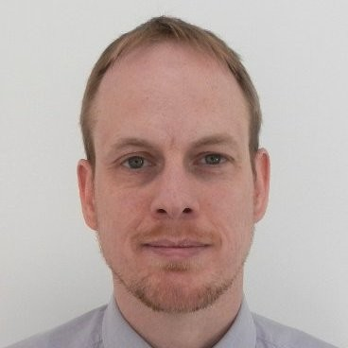
About us
Katherine (she/her)
Omar (he/him)
Connie (she/her)
Léonie (she/her)
Marcus (he/him)

Slide 6
About you
In the chat, please write:
Your name
Which area you live (or work in if outside the borough)
Why you’re here/what you want to achieve from this meeting

Slide 7
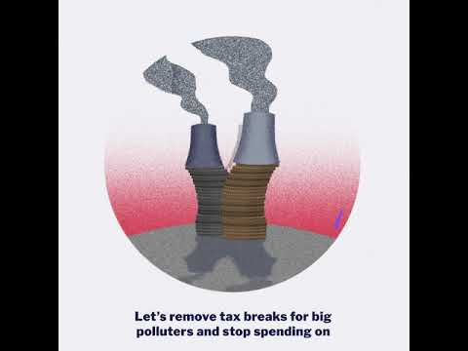
About Friends of the Earth

Slide 8
About Croydon Climate Action
Our aims
Climate Action Plans for Councils
Elections
COP26
Our scope
Support nationwide FoE campaigns
Supporting groups with similar aims
Working on local projects and campaigns

Slide 9
Campaigns
Our achievements
Social Media
Website
Meetings with LA candidates
Featured in article!
Current Campaign – Mayoral Elections 2021
10-point Plan and Pledge
Green Party and Lib Dem meetings
London working group
Other campaigns post-lockdown

Slide 10
Discussion – how you want to get
involved with current campaign
We want you to get involved!
Support for current campaign – Tweeting/messaging candidates
Any other ideas?

Slide 11
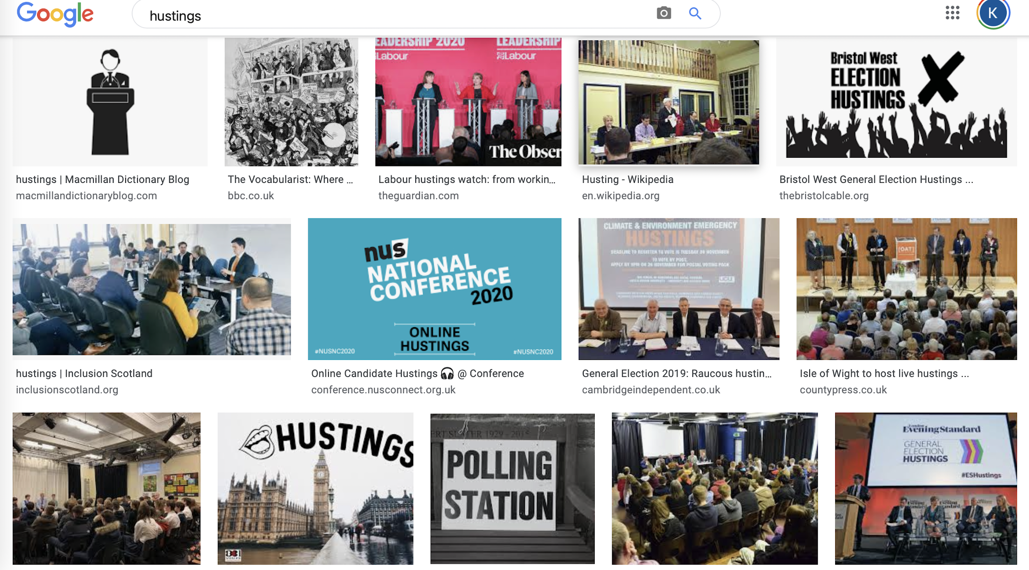
Hustings
A hustings is a meeting at which candidates in an election address potential voters

Slide 12
The future for CCA
Our longer-term aims post-Elections
Establish a Youth branch/group
Raising awareness of net-zero 2030 goal
Establish good relationships with the Council
Get more allies and other groups’ support in the community
Organically grow the group and have project leads
Outreach work to ensure better representation of Croydon communities in Climate Action work
Any other ideas?
WhatsApp group for members?

Slide 13
Wrap up
Thank you so much for attending tonight, we hope you have found it useful and will send round a short survey for how we could improve next time.
Future meetings:
Second Wednesdays of the month @ 18:30
14th April
12th May
9th June
14th July etc.

Slide 14
Contact
Website: www.croydonclimateaction.com
Email: croydonclimateaction@gmail.com
Facebook: CroydonClimateAction
Instagram: @croydon_climate_action
Twitter: @CroydClimateAct
Nextdoor: Search “Croydon Climate Action”
LinkedIn: Croydon Climate Action

