Slide 1
CCA Action Meeting
Wednesday 8th February 2023
18:30 – 19:30

Slide 2
Agenda
Welcome for new members - outline agenda (under 5 mins!)
Pesticide-Free Croydon - we are working with PAN Pesticide Action Network to campaign for Croydon to become pesticide free (10 mins)
Trees4Croydon - Find out how you can get in on the action! (20 mins)
Climate Fresk - Want to help tackle climate change but don’t have the time to become a climate scientist? (15 mins)
United For Warmer Homes - updates (5 mins)
AOB (5 mins)

Slide 3
Pesticide-Free Croydon
Working with Pesticide Action Network on the campaign to achieve Pesticide-Free Croydon
Pesticides are harmful to health and environment and are usually used in towns for cosmetic reasons
Safe alternatives are available
Pesticide-Free status awarded to towns where the council no longer uses pesticides
Croydon’s contractor Veolia still use them on verges and pavements
Opportunity to influence the Council through a survey regarding the Veolia contract renewal in 2025
Meeting with Ria, Green Party Councillor to gain Croydon Council commitment

Slide 4
Pesticide, Health and Environment
Pesticides are released for specific reasons but have widespread unintended consequences
Exposure is everywhere, agriculture, roofs, boats, parks, pavements
Pesticides contaminate soil, water, air and enter living organisms
Health effects:
Acutely toxic reaction - harmful or lethal effects after a single exposure
Chronic (or long term) toxicity - linked to the development of Parkinson’s; asthma; child development, depression, anxiety; attention deficit/hyperactivity disorder (ADHD), cancers
Environment effects:
Pesticides on plants kill insects essential to the food chain, soil and plant health, these include pollinators such as bees, decreasing crop pollination and reproduction
Pesticides kill and harm animals, birds and fish and impact their food supply
https://www.pan-uk.org/key-issues/

Slide 5
Pesticide-Free Croydon - Croydon Street Cleaning 2025 Survey
Please could as many of you as possible complete this survey by 25th February and ask others to do the same:
There are a number of questions to complete but the key ones for us are:
To what extent are the following a problem in your local area? Weeds on the public highway - select ‘not a problem at all’
Which areas in your neighbourhood tend to get dirtiest and would benefit from more attention in the future? Select ‘Other’ and you can write ‘I don’t consider weeds to be dirty, in fact I would like to see more biodiversity in my borough.’
To what extent would you support or oppose the council adopting a pesticide-free approach to weed control? Please select ‘strongly support’
Street Champions - opportunity to promote biodiversity and object to pesticides. Recommend supporting Street Champions.
https://www.getinvolved.croydon.gov.uk/waste-street-cleaning-services

Slide 7
Agenda
Introduction
Plan
Progress
How you can get involved
Q & A

Slide 8
Objectives
Key Components
Trees4Croydon is a mass participation and engagement initiative to raise money for tree-planting projects in deprived areas of Croydon. Benefits from tree planting include:
More equitable access to trees/ green spaces in the borough;
• Enhanced biodiversity;
• Greater carbon sequestration; and
• Cooler neighbourhoods.
Indirect benefits from the initiative include: greater awareness of the climate, biodiversity and social crisis; and greater cohesion in the borough in battling this crisis
Participation planned from all key constituencies e.g. businesses, schools, faith-groups, NGOs, friends and family
Participants will walk/ run/ cycle/ travel by wheelchair from 5 weeks from 10/06. Progress gamified on atlasGO
Funding will come from organisations sponsoring 5,000 mile milestones, from teams and individuals fundraising, and from grants
Funds will be provided with conditions to a partnership including Trees for Cities and CC for planting and maintenance
Trees4Croydon builds on experience from: Walk2COP27 – watch the 5 minute summary

Slide 9
The Plan
Set-up
Recruitment & funds
Get moving
Project initiation
Comms & media
Define project
Build team
Engage with key partners & test
Set up systems and structure
Outreach to all key constituencies for participant and funding pledges
Stimulate in-bound enquiries
Promote to the public
Run registration
Manage participants during the 5 week event
Work with partners to identify projects
Hand over funds
Build key media assets e.g. comms documents, website, IG, LI
Engage media orgs
Support all stages

Slide 10
Progress
Management
Engagement
Project defined & tested
Core team established
Way of working established
Charity vehicle confirmed (Change Drivers)
Engagement groups identified and allocated
Business (Sam & Lisa)
Education (Anna & Léonie)
NGOs, Youth & Community Groups (Chris)
Faith-groups (John)
Care homes (Elaine)
Sports clubs (Connie)
Council (Léonie & Sam)
Croydon250, the largest Croydon based organisations mapped
Outreach to over 50 organisations, details recorded
Highlight of outreach: matched funding from Trees for Cities, Council engagement including Scott Roche, Nick Hibberd
Comms & Media
Visual identity developed
First version of website built
First social media post
Infrastructure
Teams environment established
Funding and walking gamification apps assessed

Slide 11
How you can get involved
Make a pledge to lead a team. How many participants?
We will put this on the website
Might be Friends and Family, your workplace etc
Plan how to best engage them e.g. a Team outing, walk etc
Offer to engage with your network or other organisations
Aim is to secure participation pledges and (where appropriate) sponsorship or funding pledges from team leaders
Provide promising contacts for team leads to the core team
Keep us informed of any activity so we can ensure its documented & not duplicative
Stay with us! Keep up to date, engage with Trees4Croydon on social media, talk about Trees4Croydon at every opportunity

Slide 12
Questions?

Slide 13
+
Notes:
Co-incidentally Sam Baker and I have both attended Climate Fresk workshops and trained as facilitators and we’d like to talk to you about how we think this tool could benefit CCA

Slide 14
Why?
CCA Stands for… engaging with Croydon community in raising awareness of the climate and ecological emergency*
1. Climate Fresk offers us a ready made way to engage with all groups and individuals in Croydon
People-led change needs educated, informed citizens who feel united
2. It provides the basic narrative of Climate Change and its consequences and ends with a pragmatic discussion about Climate Action
We need 25% of the population on board to counter the status quo of slow or no action
3. Anyone can train as a facilitator at minimal cost and time
Let’s use Climate Fresk to help us build to the 25%!
* CCA September 2022 meeting CCA Resources
Ref: Our theory of change - Climate Outreach, Scientific American: The 25% Revolution
Notes:
One of the things that CCA stands for is engaging with Croydon community to raise awareness of the climate and ecological emergency. We all come to CCA with different perspectives and aims for the group and ourselves.
CCA has a roadmap of different activities and we think that Climate Fresk workshops give us a tested tool to engage with others and build towards the 25% that we need on board to drive a people-led change for actions to address the climate emergency.
I’m going to take you through WHAT Climate Fresk is, HOW it works and WHY it’s been a success and then talk about our proposed plan. We’d then like your feedback about it.

Slide 15
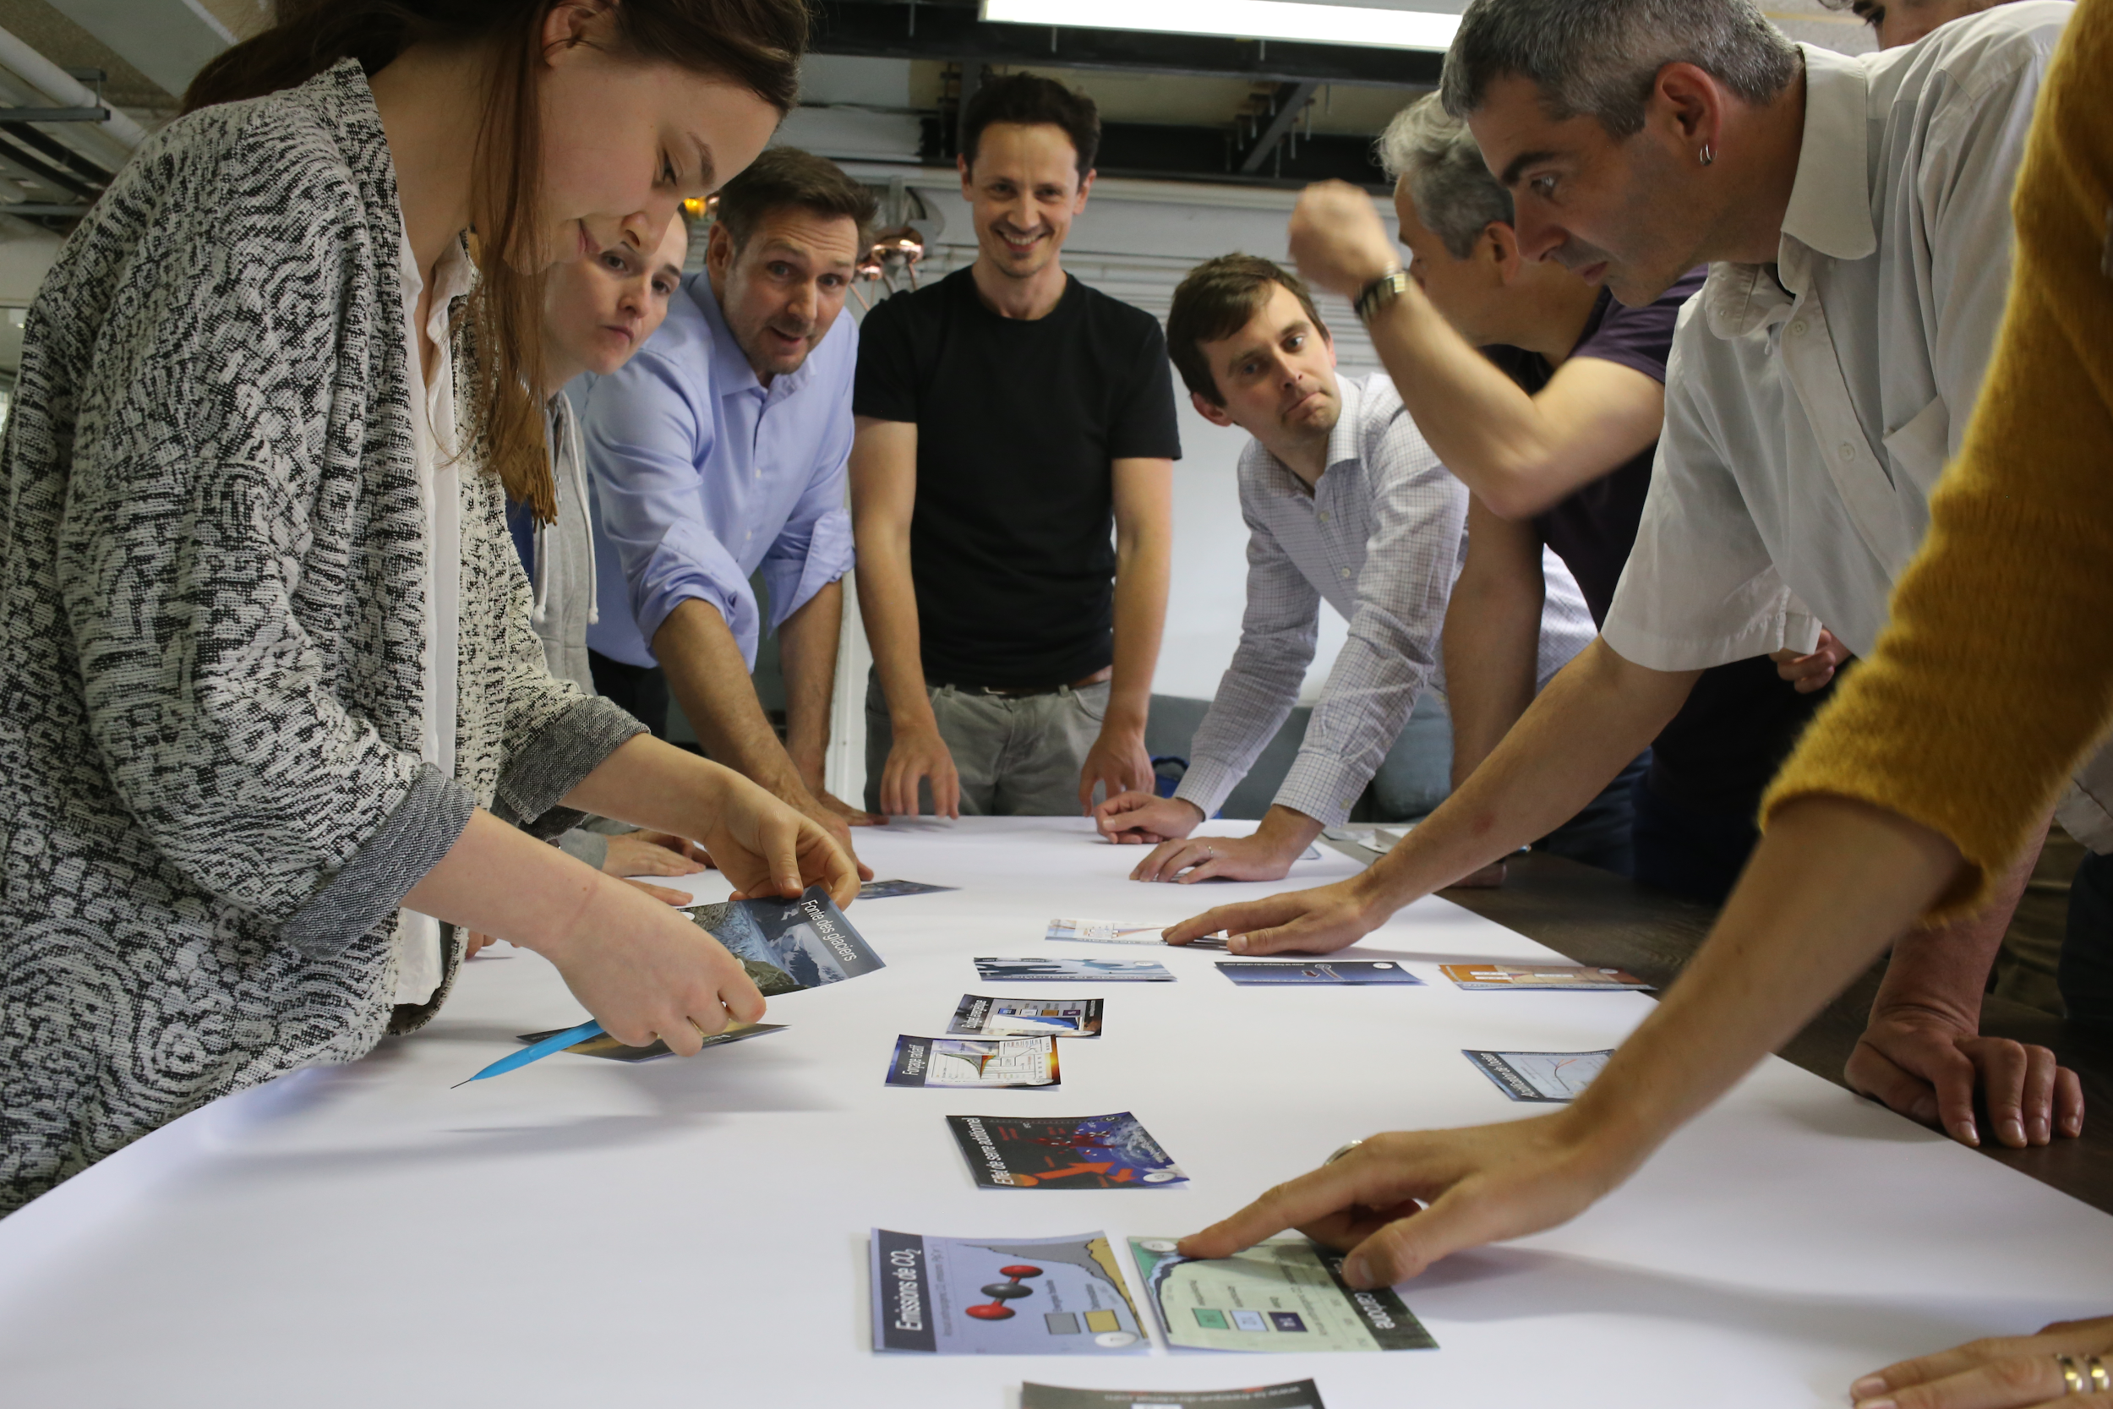
Climate Fresk – What Is It?
Based on the IPCCs’ reports, it is a collaborative workshop that uses 42 cards to visualise and understand the causes and consequences of climate change.
Offline version
Online version
Notes:
Visual tool – 42 cards – used to build a network of connections showing causes and effects of climate change
Scientifically based – on the IPCC reports (intergovernmental panel for climate change)
Collaborative – groups of 6-8 – learn from each other and supported by a facilitator
No expertise or prior knowledge required – just an openness to listen to others and participate in discussions

Slide 16
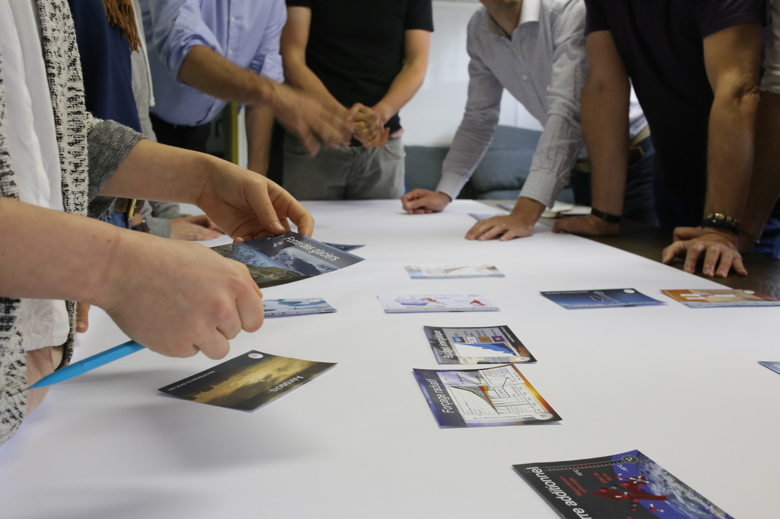
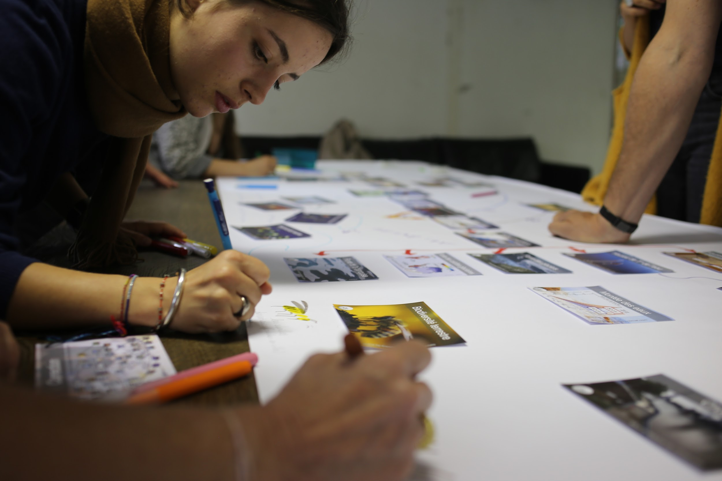
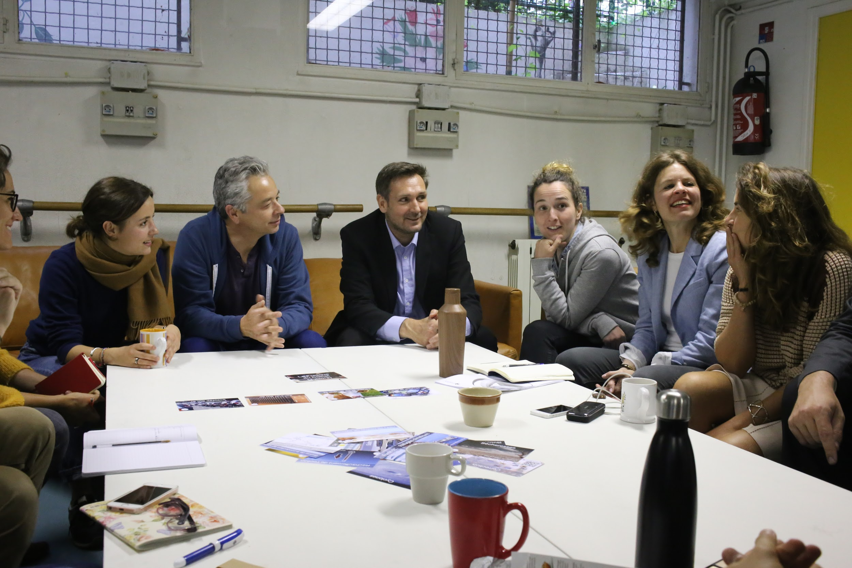
The Climate Fresk workshop
Reasoning - 1h30
Discovering and linking the 42 cards and creating the collage.
Creativity - 20 mins
Relaxing, taking ownership of the collage by decorating it.
Discussion – 50 mins
A calm discussion on
the participant’s emotions,
positions, questions to
brainstorm over individual and collective solutions.
Intros/ get to know each other
Conclude (and plan!)
A simplified 2h workshop with 21 cards is available for kids/ESOL
Notes:
The most important part of the workshop is the final discussion about what the participants feel about what they have learned and exploring potential solutions – everyone should leave with actions they can take

Slide 17
Snowball Effect
Scientifically robust
Fun
Easy to implement
Creative Commons licencing
After a course of 3 hours, a participant can be a facilitator

Slide 18
Climate Fresk is well established
400
Universities
Business Schools ...
+840,000
participants
38,000
facilitators
1,000
Companies
50
countries
35
languages
+ many NGOs, schools* and individuals
* there’s a simpler, shorter Fresk for schools
Notes:
It’s a tried and tested tool, originating in France, but now used worldwide.
Once you’ve participated in a workshop you can attend a 3 hour training session to learn to be a facilitator – that’s the stage Sam and I are at.
A facilitator can run workshops for the public or in their work organisation, subject to the licensing conditions of Climate Fresk. There’s also a qualification process for Pro facilitators to run paid for workshops in businesses and educational establishments.

Slide 19
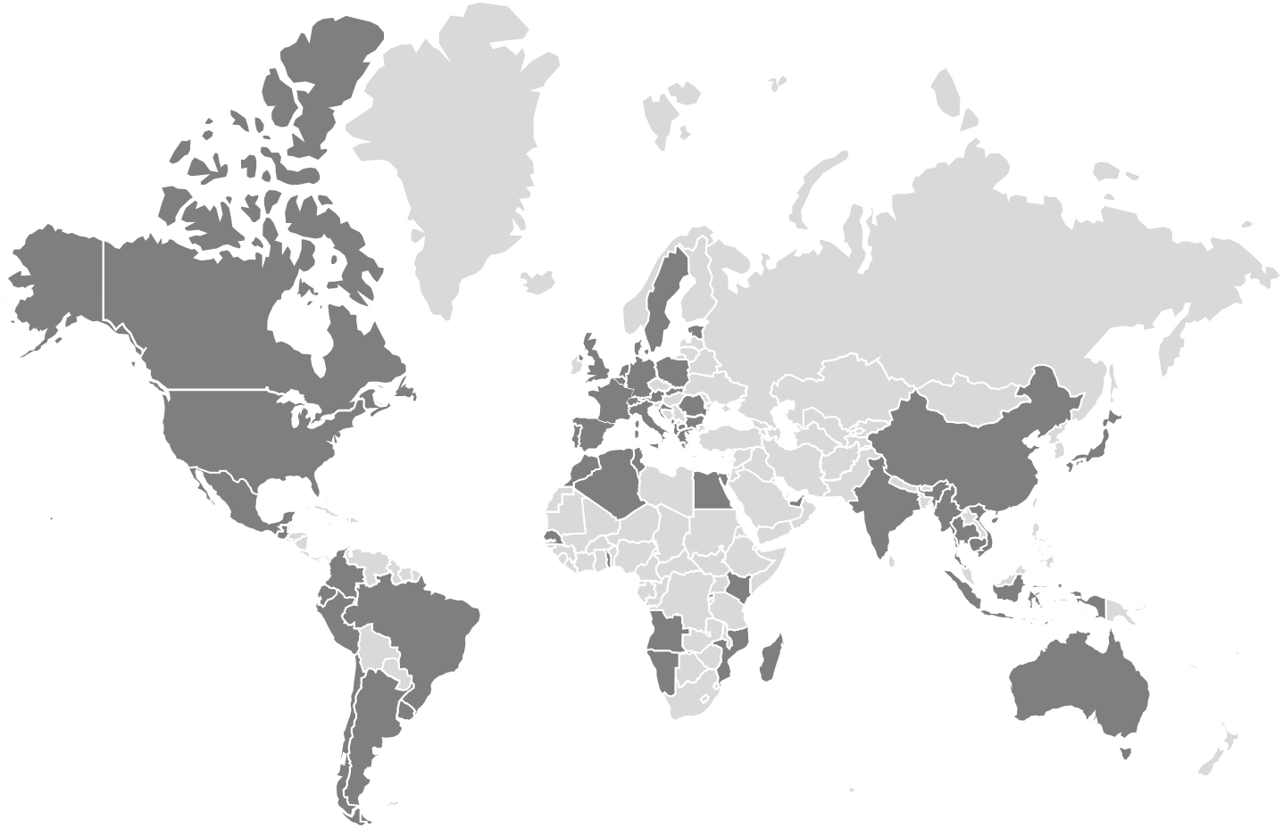
50
countries
35
languages

Slide 20
Why is it such a success?
PLAYFUL
Our workshop is playful, fun and educational.
COLLABORATIVE
The workshop fosters team spirit and collective intelligence.
.
VISUAL
Because a picture is worth a thousand words.
CREATIVE
Time to be creative! Make your Collage unique: give it a title, add drawings etc.
SIMPLE
You only need the deck of cards, pens, paper, a table, and you are all set!
SCIENTIFIC
The content is based on the IPCC reports - the most reliable source of climate related data.
Notes:
Reasons that it works across different situations and across different geographies

Slide 21
What they say
Notes:
Leave out as very dense and no attribution of quotes. Want to have time for discussion of next steps and feedback.

Slide 22
The plan for CCA
Sam and Cathy to run workshops for the CCA over the next 8 weeks
The workshops will:
Help us get to know new CCA members
Enhance our knowledge
Help us commit to action
Set us up to take the next step to being facilitators
2. Members to brainstorm potential on the 05/04
Do we think we can further our goals by rolling out in the borough?
How might we work this into our existing CCA initiatives?
How many want to become facilitators?
Develop roll-out plan
Notes:
2 step plan has been agreed for CCA with Leonie
Step 1 – Sam and Cathy run workshops for CCA
-> allow others to experience it
-> good way for CCA members to get to know each other and incorporate new members
-> helps enhance our knowledge
Step 2 – when more CCA members have experienced the Fresk workshop
-> brainstorm the potential for CCA and the borough

Slide 23
Today’s ask
Sign up for a workshop with Sam and Cathy!
Email: Sam (sambaker@impactstrategy2030.com) and Cathy (cjdriscol@gmail.com) specifying
preferred times of day and days of week
face to face or virtual
planned events that could incorporate a Climate Fresk workshop
Or…. add in the chat NOW
Notes:
We’d like to arrange some workshops in the next 8 weeks and need your feedback on when and where works for you

Slide 24
Questions ?
Notes:
Thoughts?
Are you interested in participating in a workshop?
Where?
When?
Events that could host a workshop?
What would stop you? What puts you off?

Slide 25
Croydon United For Warmer Homes
Can you help:
Sign and share the petition https://actionnetwork.org/petitions/croydon-mps-to-take-action-for-warm-homes/
Help contacting local businesses and groups to build support for the petition
Organise a ‘Croydon for Warm Homes’ event with our MPs on this topic

Slide 26
AOB
Sustainable Thornton Heath hub - Saturday 25th Feb, 1-4pm, Salvation Army Thornton Heath
Next Croydon Climate Action meeting - Wednesday 8th March, 6.30pm
Next Green Social Meeting in Spread Eagle pub - Wednesday 15th March from 7pm
Anyone able to attend Legacy Youth Zone on Thursday 30th March 9:30am - 2:30pm
They are planning an event which is focussed on caring for our planet, encouraging our children to be global citizens and respect nature and the environment. It could purely be a table stall with information about your group. This would also be a great opportunity for you to spread the word about your group to hundreds of people in the Croydon community.

