Slide 1
CCA Meetup
Wednesday 14th July 2021
18:30 – 19:30

Slide 2
Agenda
New committee member!
Green Alliance info
GBGW Update
Stop Cambo campaign
Croydon MP Groups
Plastic-free July update
Any other business (AOB)

Slide 3
Welcome to Anna!
Anna Orridge is joining us on the CCA Steering Committee
Also does work with Croydon Greenpeace

Slide 4
Croydon Green Alliance
Joined a coalition of green groups in Croydon, including XR, Greenpeace, Sustainable Thornton Heath & Croydon Transition Town.
Meeting with Cllr Muhammad Ali re: CCCC recommendations
Joint action against leasing of Heathfield House

Slide 5
CGBGW
We have secured £2000 of funding!!
List of events and stallholders is growing
Deadlines:
26th July → stallholders at the festival on 26th September
2nd August → hosting events between 18th-25th September
We are making social media posts - please share these once ready!

Slide 6
Stop Cambo campaign
Energy company Siccar Point and oil giant Shell have plans to open a huge new oil field in the Cambo Field, West of Shetland.
Please sign and share the petition to stop this!
You can find out more information about the proposed plans & actions you can take here

Slide 7
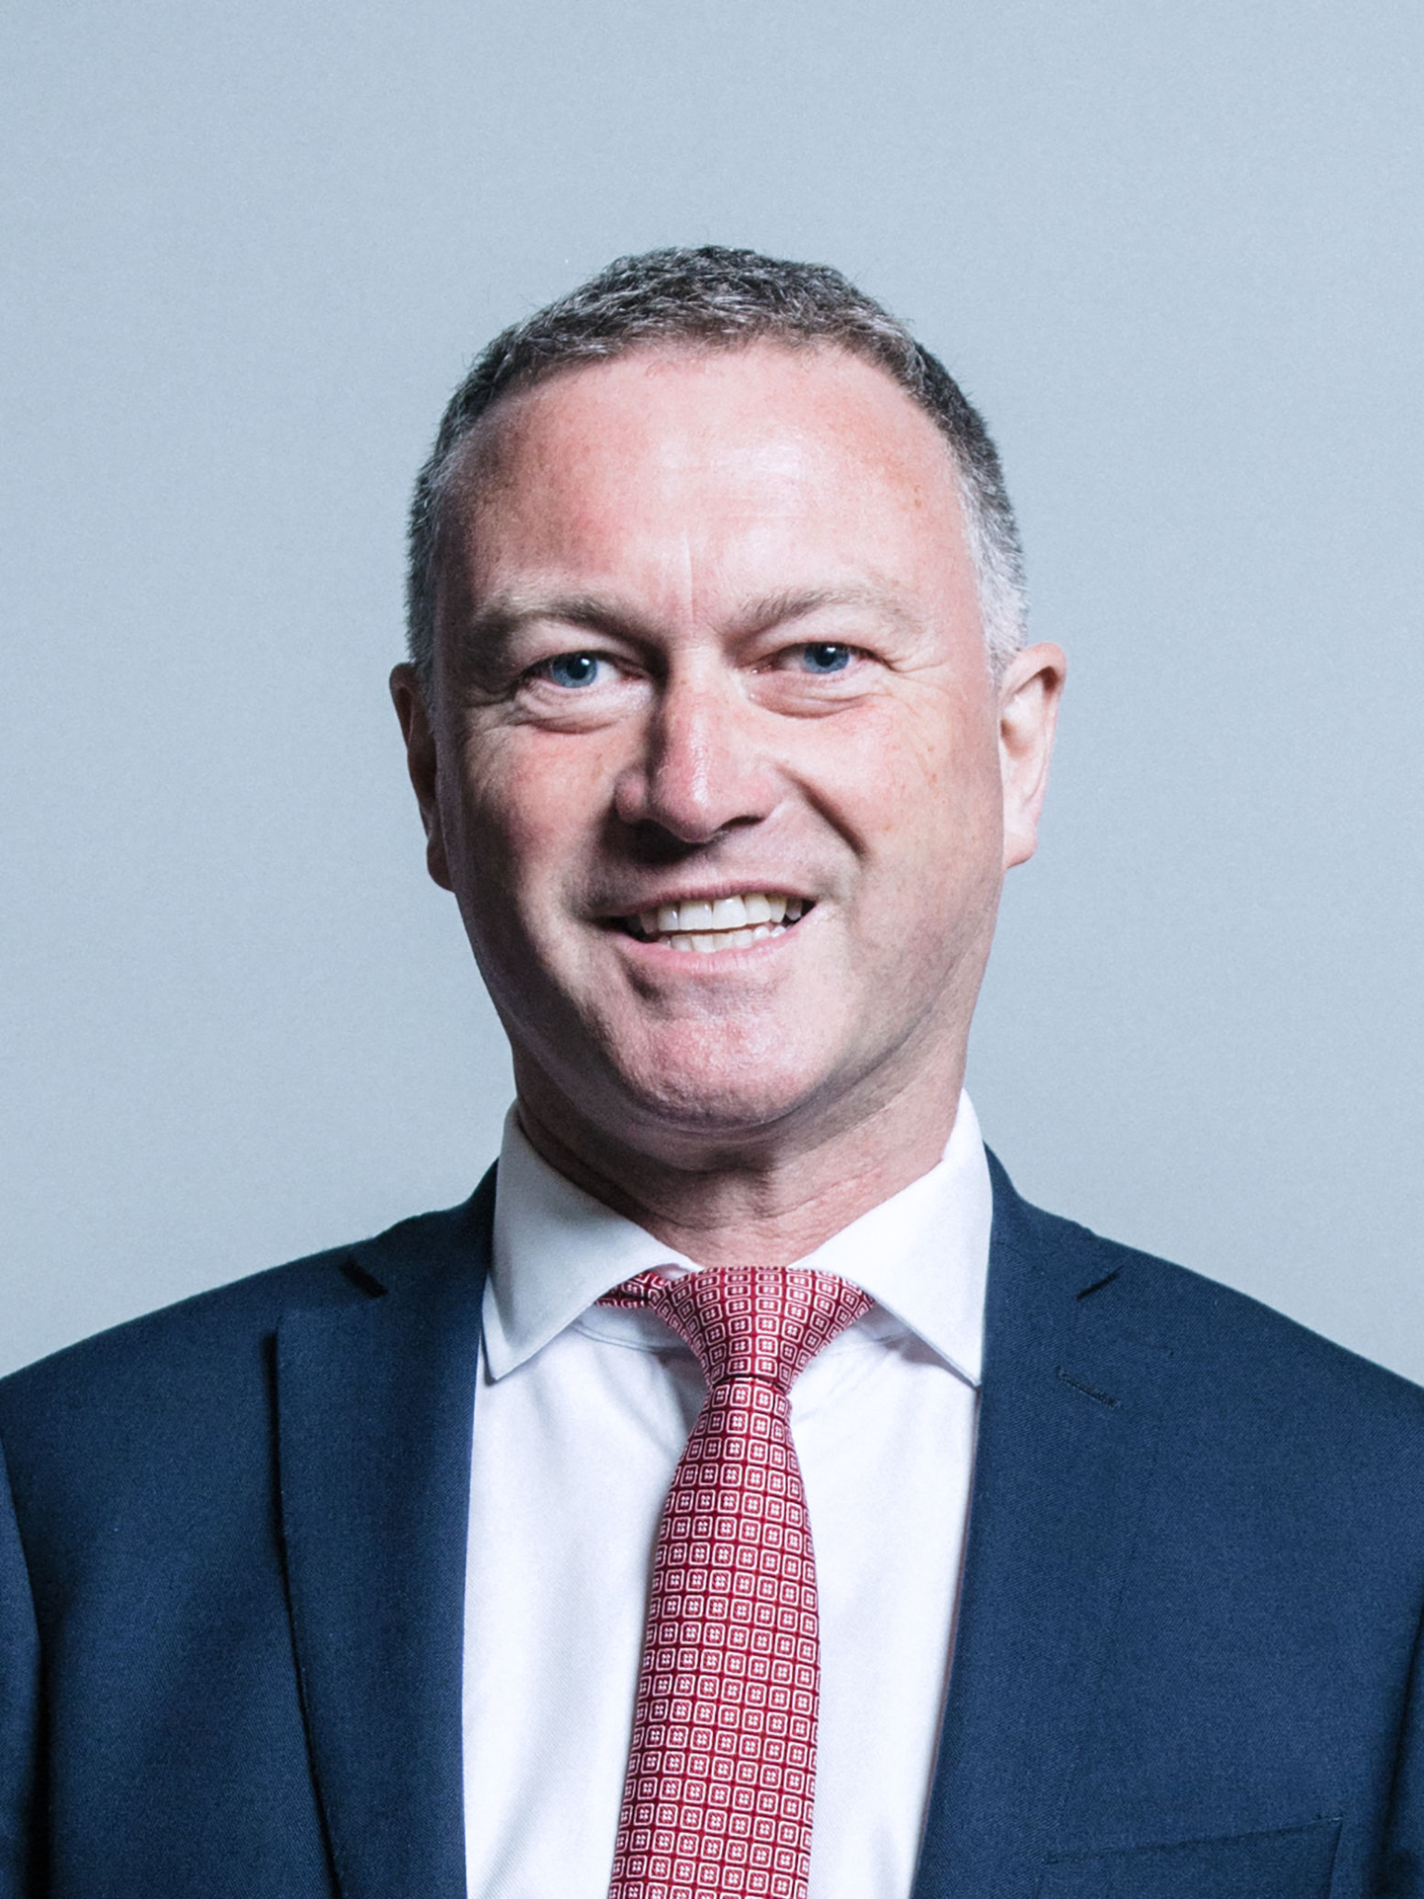
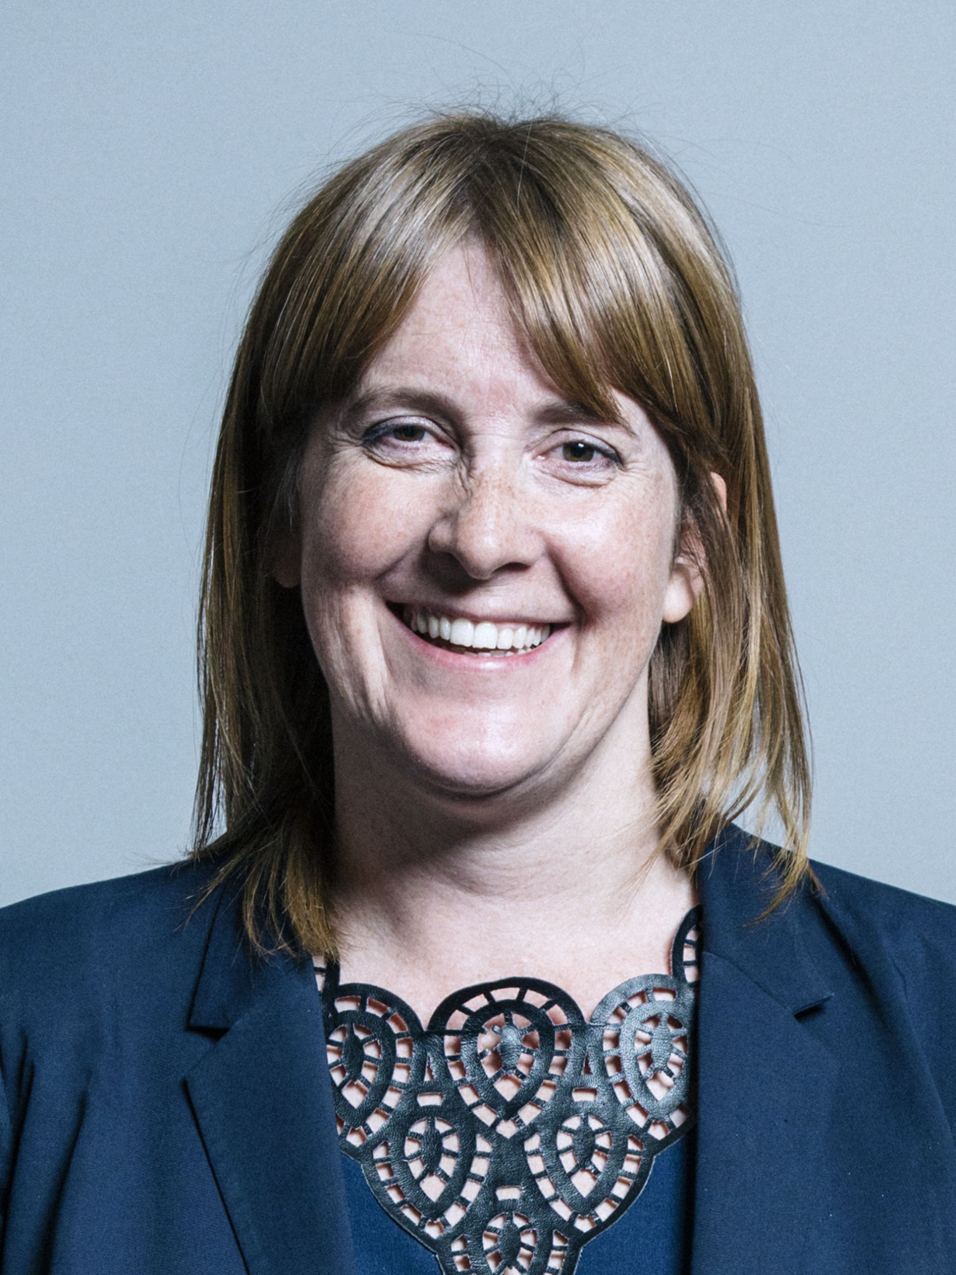
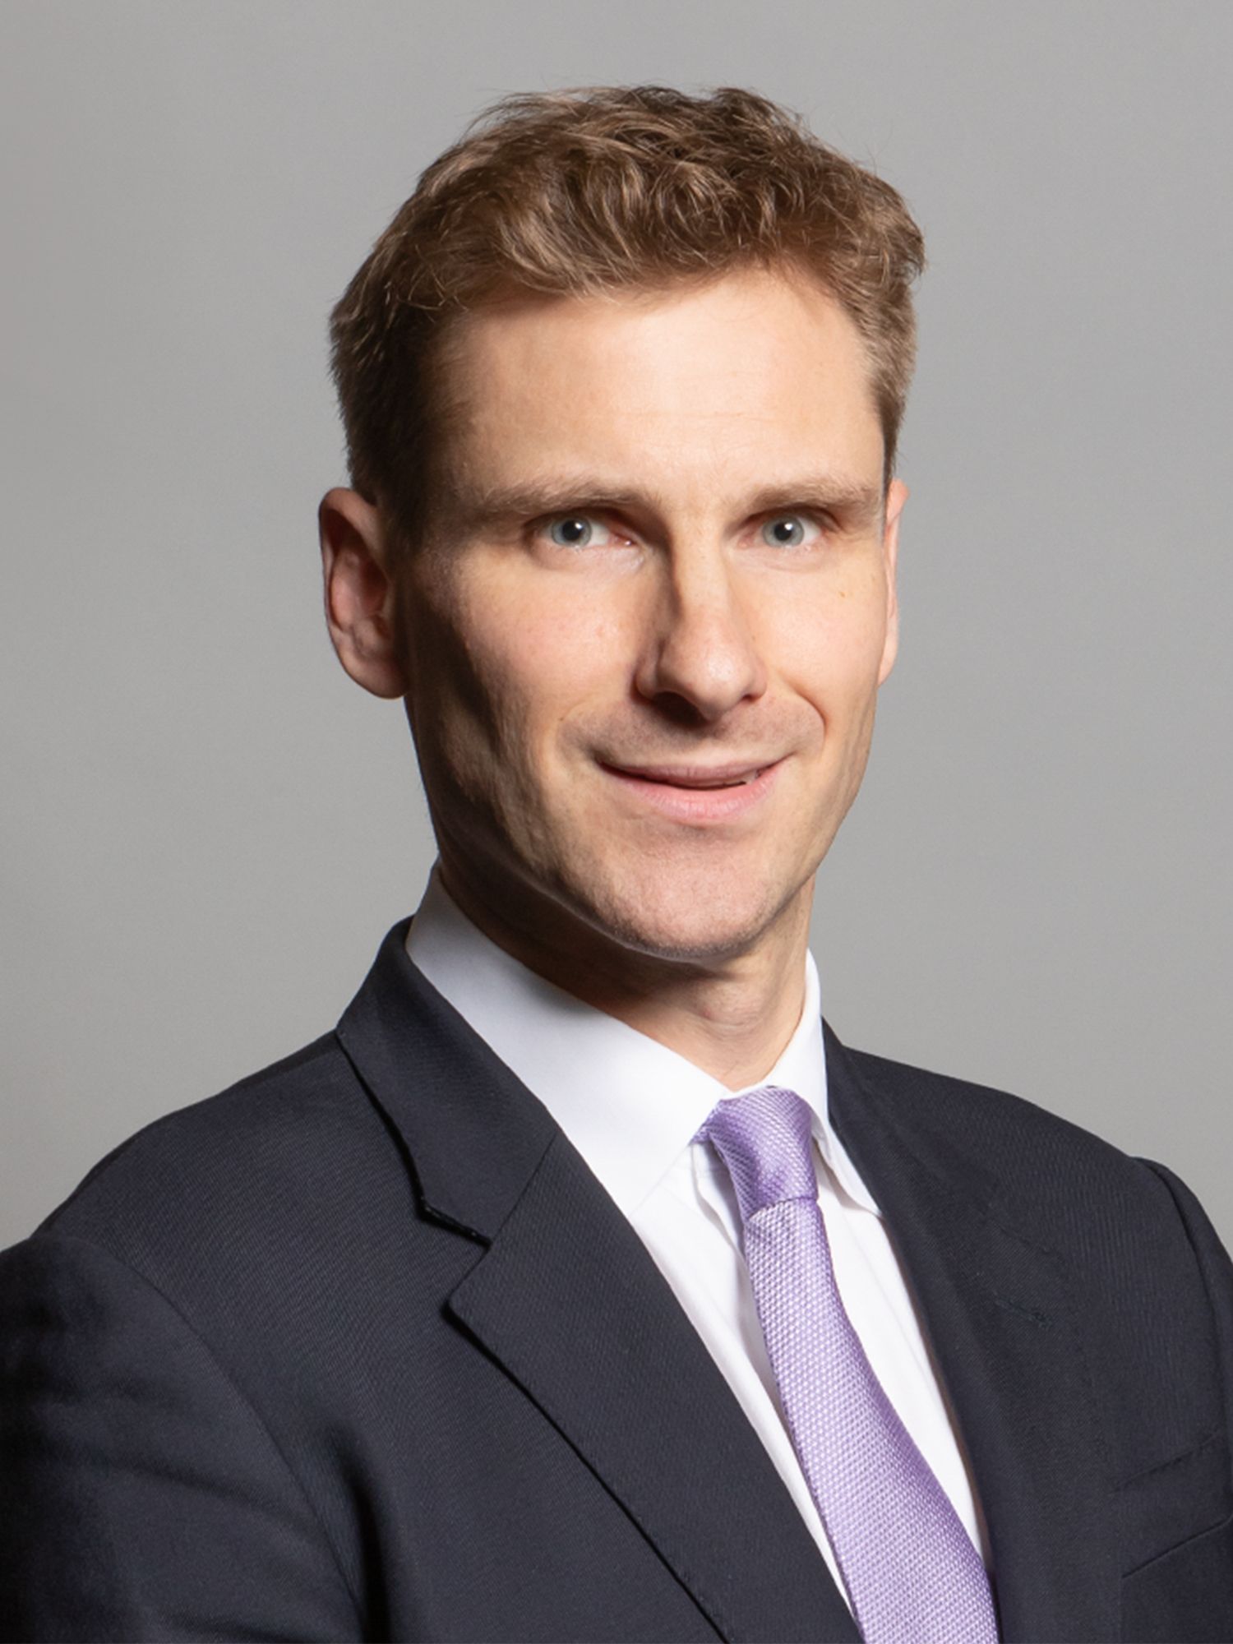
Croydon MP Groups
Now 3 groups covering Croydon North, Croydon Central and Croydon South who are planning to meet with their MPs about climate issues at a governmental level.
Would anyone like to join?
Ian Morris → Croydon North (Steve Reed)
Liz Bebbington → Croydon Central (Sarah Jones)
Connie Muir → Croydon South (Chris Philp)

Slide 8
Plastic-free July Update
Collections of single-use plastic underway
Taking it to Sainsbury’s Thornton Heath on Monday 2nd August @ 4pm
Please give us your Sainsbury’s plastic if you can’t make it!
Send us photos of your plastic you’ve collected

Slide 9
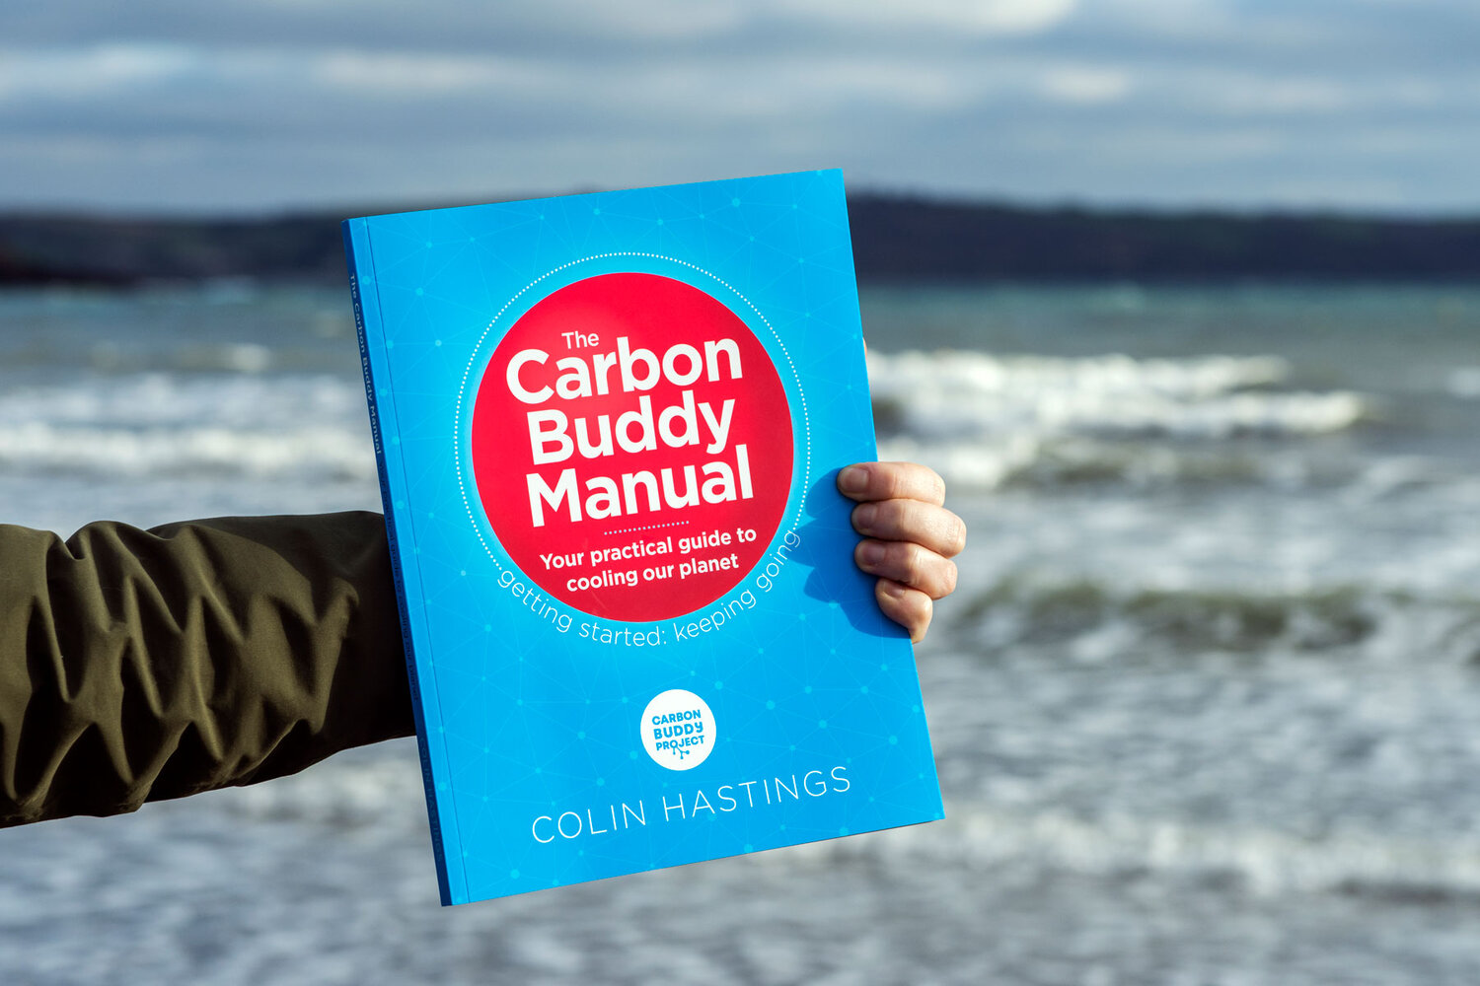
Any other business
UK Open Dialogues series throughout August here
COP26 Moths to a Flame art installation
London National Park City anniversary week events
The Carbon Buddy Manual - still have copies!
Join a fun active clean up here

Slide 10
Next meetup:
NO AUGUST MEETING
Wednesday 8th September
18:30 - 19:30
We have a WhatsApp group – join using this link: https://chat.whatsapp.com/DlJKqszwLQb8aPagYzJ9qH

