Slide 1
CCA Meetup
Wednesday 10th November 2021
18:30 – 19:30

Slide 2
Housekeeping Rules
Aim for 2 minutes when discussing ideas
Be respectful of everyone
Remain non-party political
Try to stay on topic as much as possible!

Slide 3
Agenda
Photos from the Action Day March - Anna (2 mins)
Feedback from Sarah Jones MP “Croydon Climate Forum” - Léonie (10 mins)
Mayoral candidates’ climate pledge - Connie (15 mins)
Volunteer positions & documents - Omar (5 mins)
End of year social - Omar (2 mins)
Feedback on recent activities & AOB - Marcus (remaining time)

Slide 4
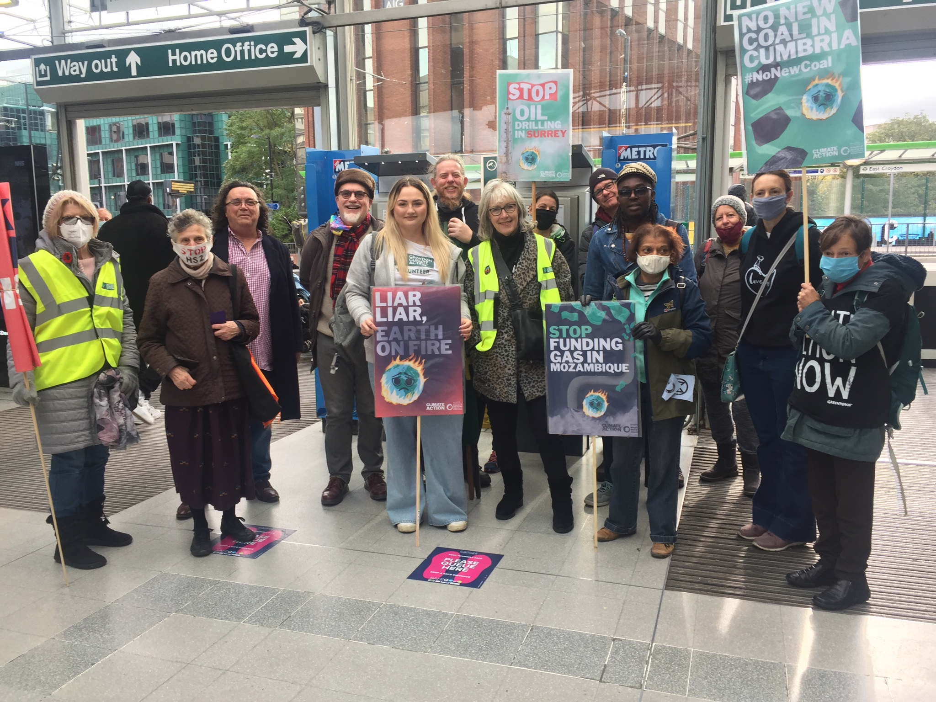
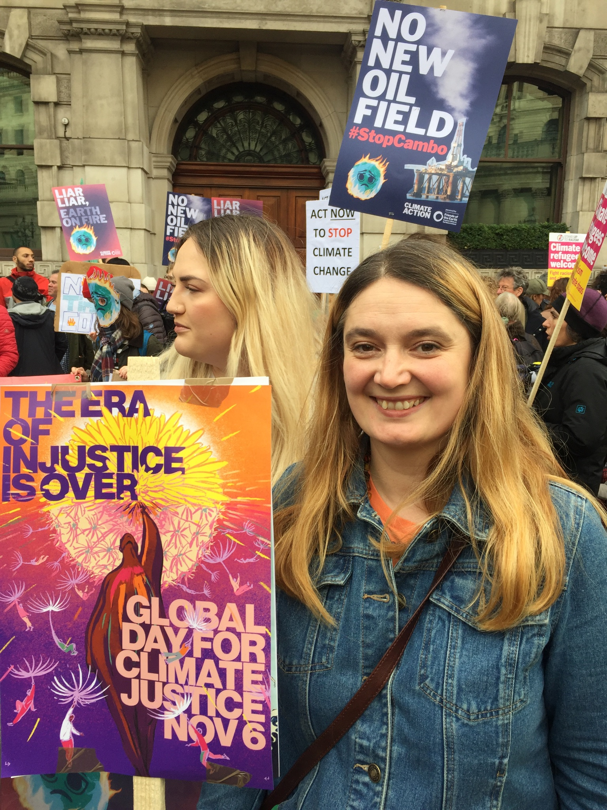
Global Day of Action - 6th November

Slide 5
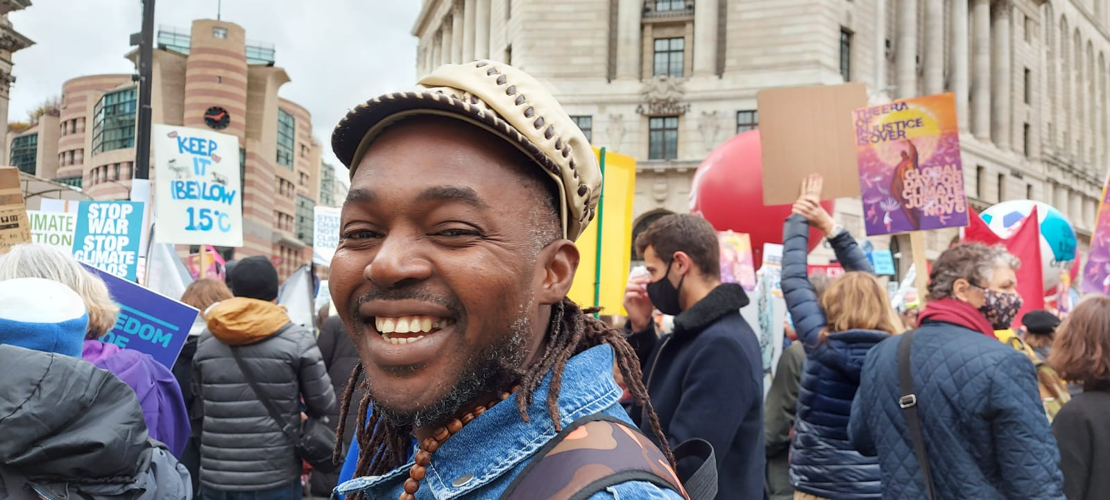
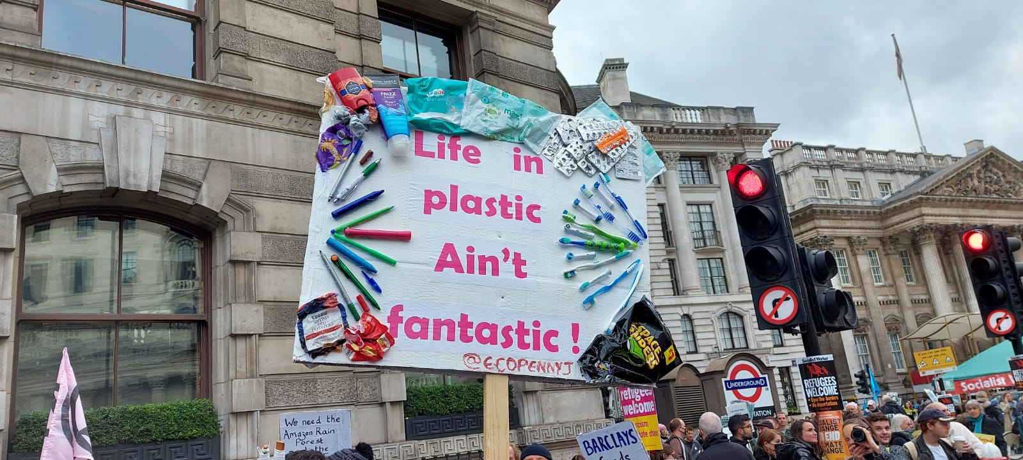
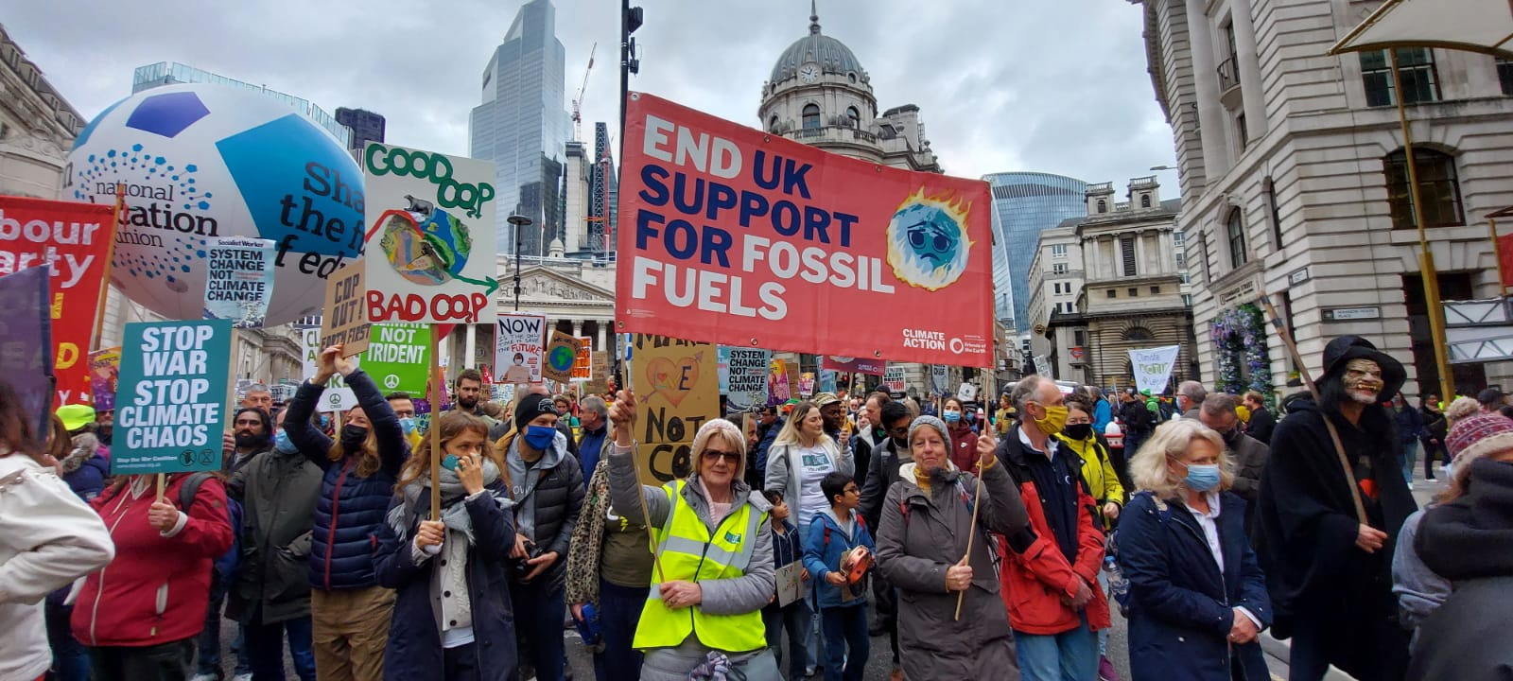
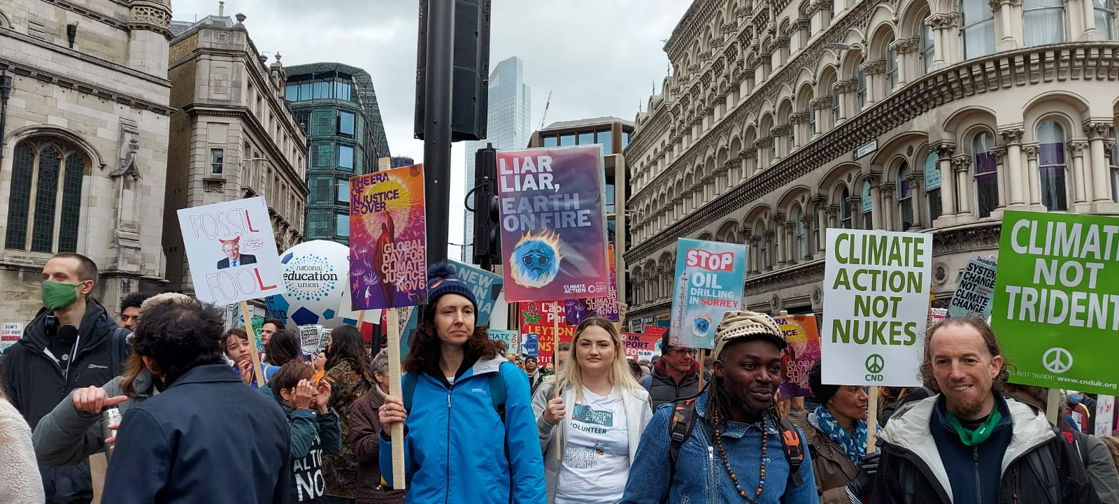
Global Day of Action - 6th November

Slide 6
Sarah Jones MP Meeting
First Croydon Climate Forum, hosted by Sarah Jones
Heard about good things already happening in the borough (including from Connie & Léonie)
Split into groups to brainstorm what we would do if we got small grant funding (e.g. £10k)
Breathe London application

Slide 7
Mayoral Elections
Local elections in May 22 for Mayor of Croydon
We want to write a climate pledge for them to take
Organise another hustings - maybe in person this time?
Invite schools
Who wants to be involved? Sign up here.

Slide 8
Volunteer positions & docs
We have the following volunteer roles at the moment:
Treasurer
Newsletter creator
Secretary
All details can be found here: https://www.croydonclimateaction.com/volunteering
Also looking for people to support us write a volunteer policy, safeguarding policy & our constitution.

Slide 9
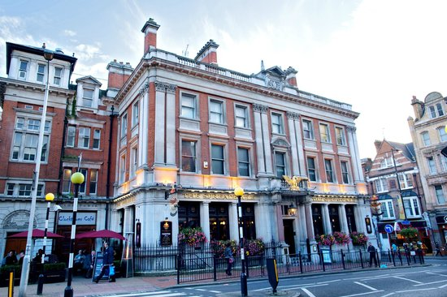
End of year social!
We are hosting an end of year social on Thursday 16th December at 7pm at The Spread Eagle Pub!
If you would like to come, email us or RSVP here:
https://www.eventbrite.com/e/croydon-climate-action-end-of-year-social-tickets-195354830557

Slide 10
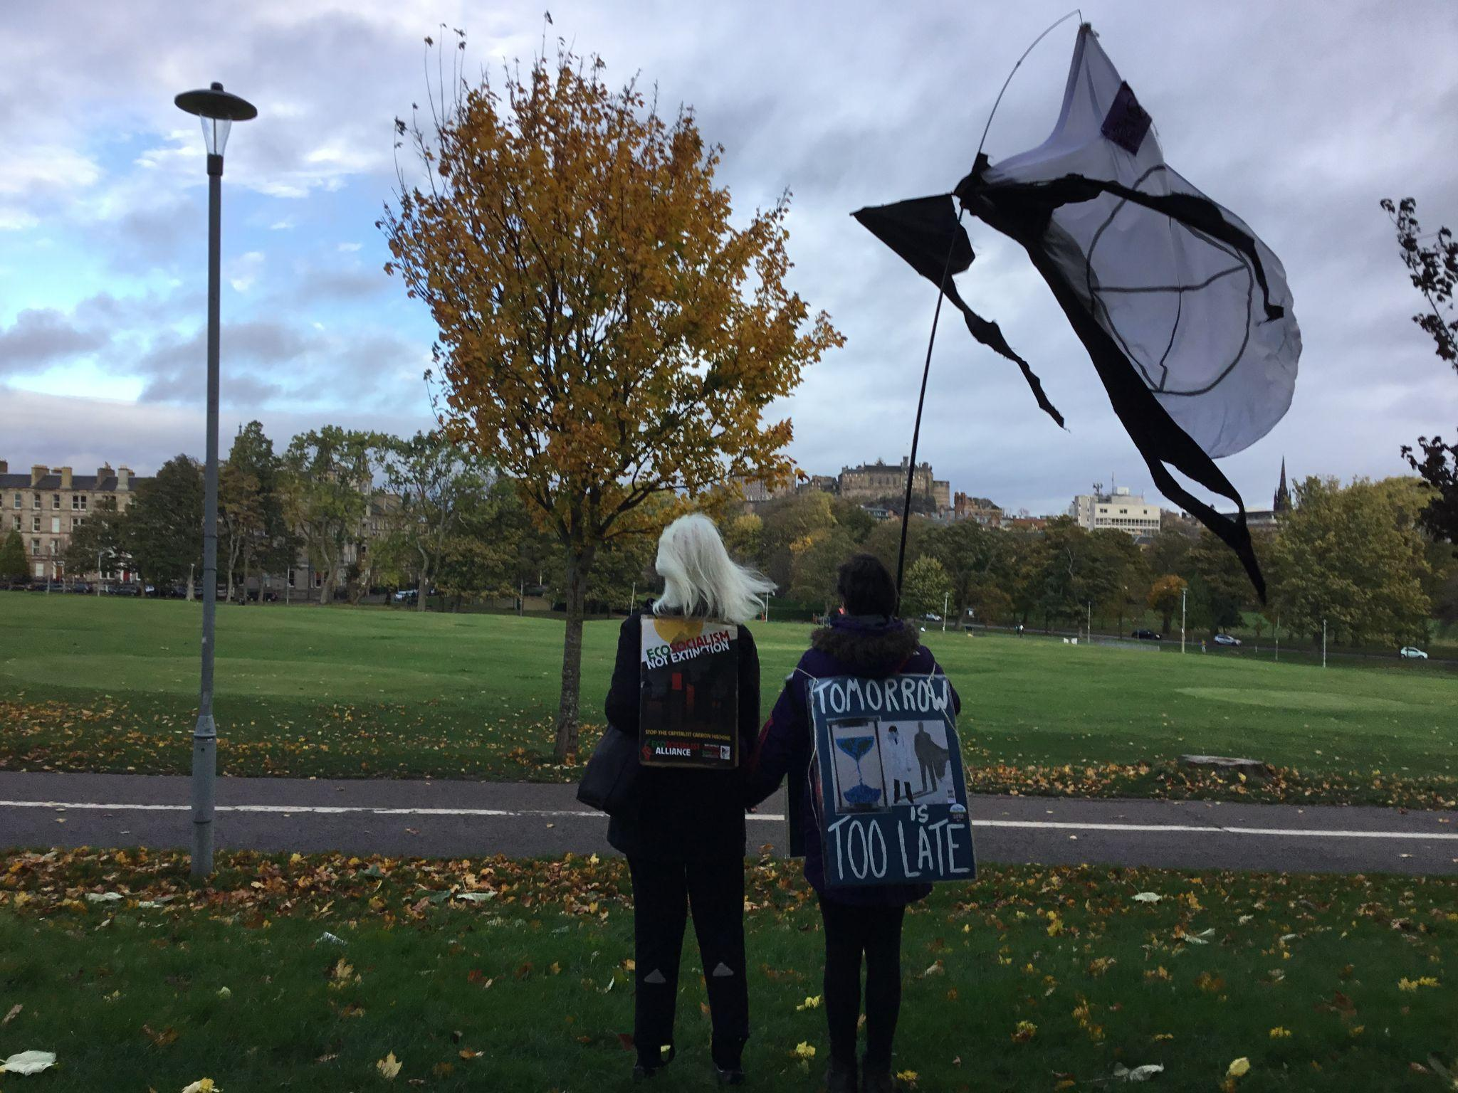
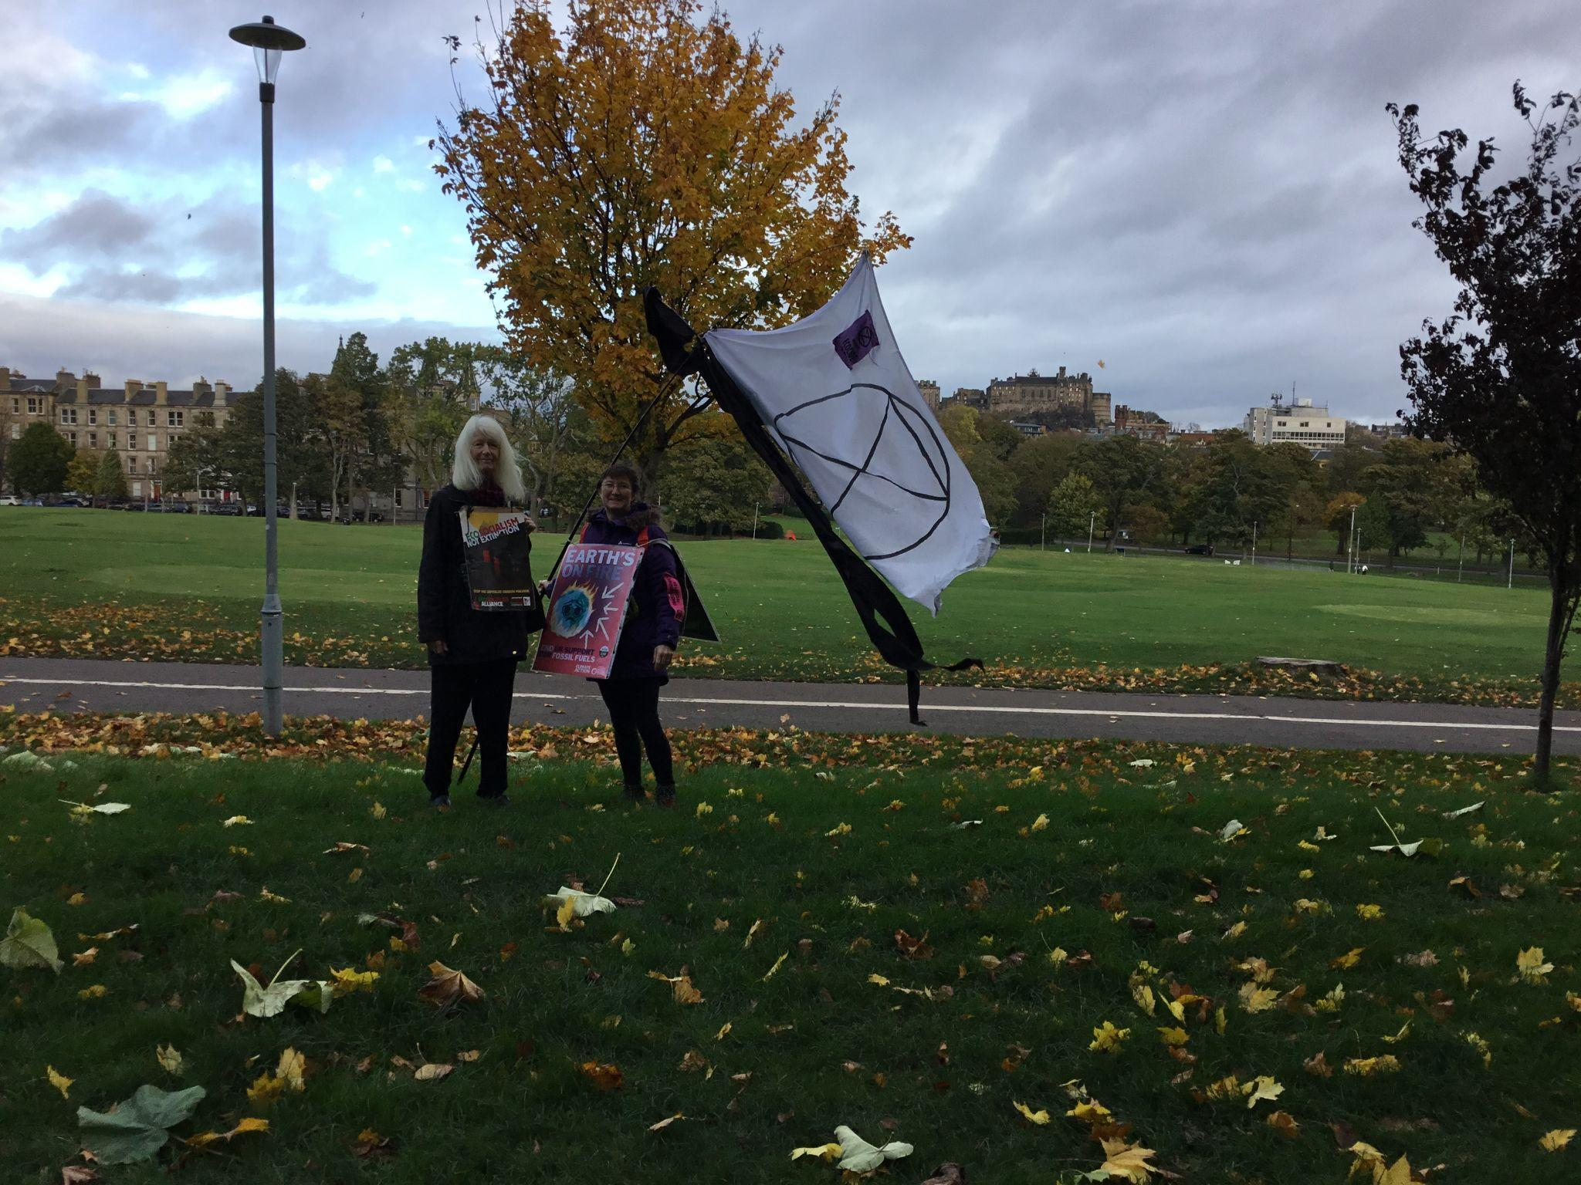
Feedback on recent activities discussion

Slide 11
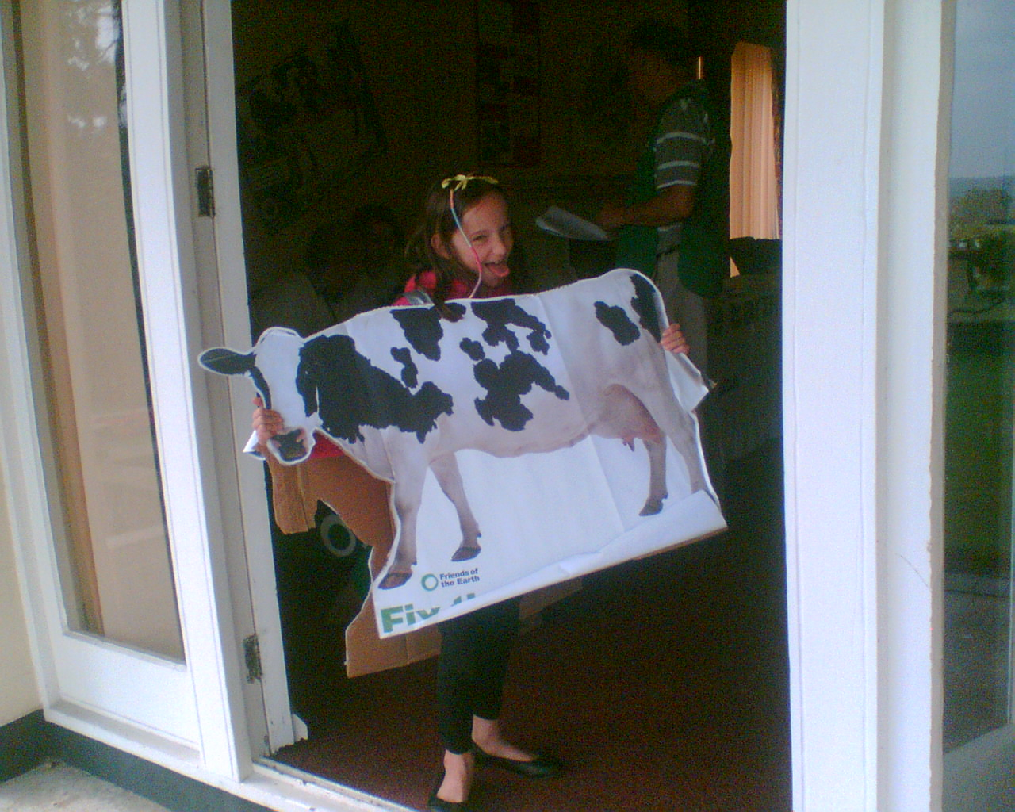
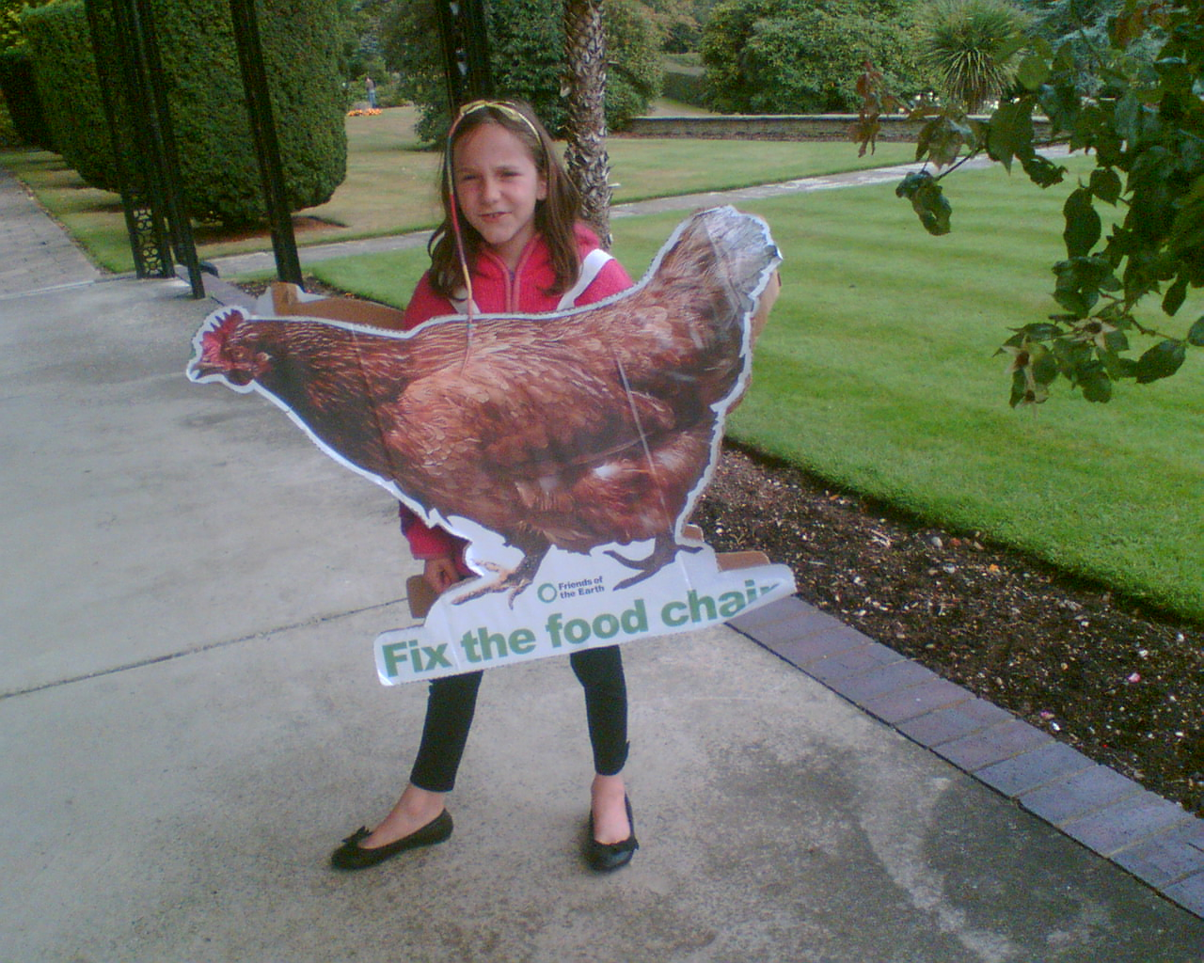
Feedback on recent activities discussion

Slide 12
Feedback on recent activities discussion
Anyone attended any events?
Groups meeting with Croydon MPs - here
Rivers in your area campaign - anyone interested?
“Our Beautiful Croydon” photography competition - let us know venues for a rotating exhibition.

Slide 13
Next meetup (after end of year social):
Wednesday 12th January 2022
18:30 - 19:30
We have a WhatsApp group – join using this link: https://chat.whatsapp.com/DlJKqszwLQb8aPagYzJ9qH

