Slide 1
CCA Meetup
Wednesday 11th May 2022
18:30 – 19:30

Slide 2
Housekeeping Rules
Aim for 2 minutes when discussing ideas
Be respectful of everyone
Remain non-partisan
Try to stay on topic as much as possible!

Slide 3
Agenda
Welcome-10 mins
Croydon Council Elections- what do the results mean for CCA and what are our next steps? Léonie -20mins
Great Big Green Week - what can we do to celebrate Croydon’s successes?
Katherine and Léonie -20 mins
Upcoming Events-Omar and Anna-10 mins
Big Plastic Count
World Environment Day
FOE Groundswell
Croydon Green Spaces Open Day
Sustainable Thornton Heath Hub
AOB and date of next meeting.

Slide 4
Welcome!
Discussion / write in chat:
What positive eco-news have you discovered this month?
Notes:
Madeleine Cuff (newsletter@news.inews.co.uk)
happyeconews.com

Slide 5
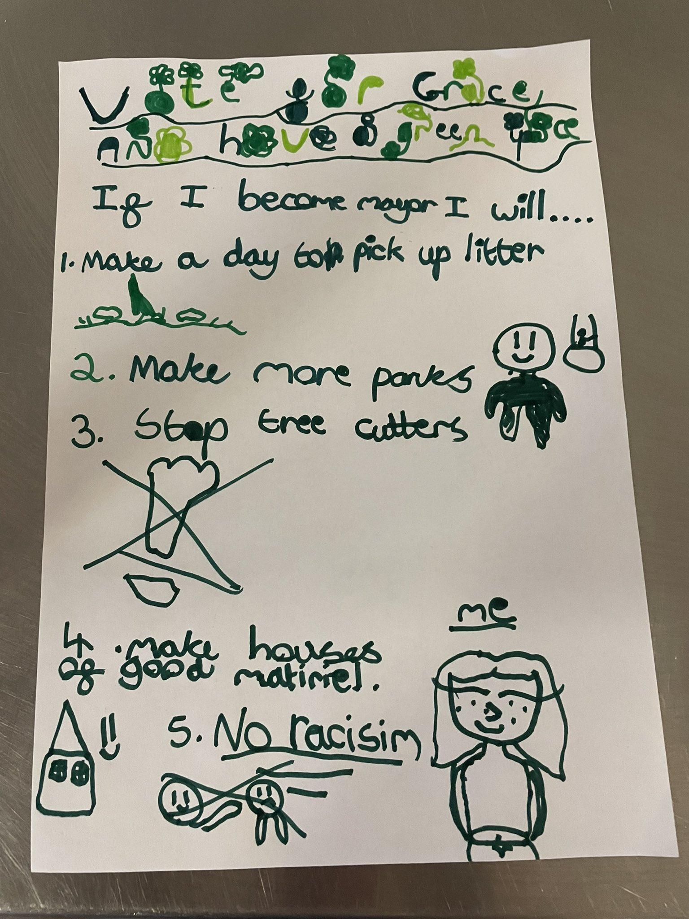
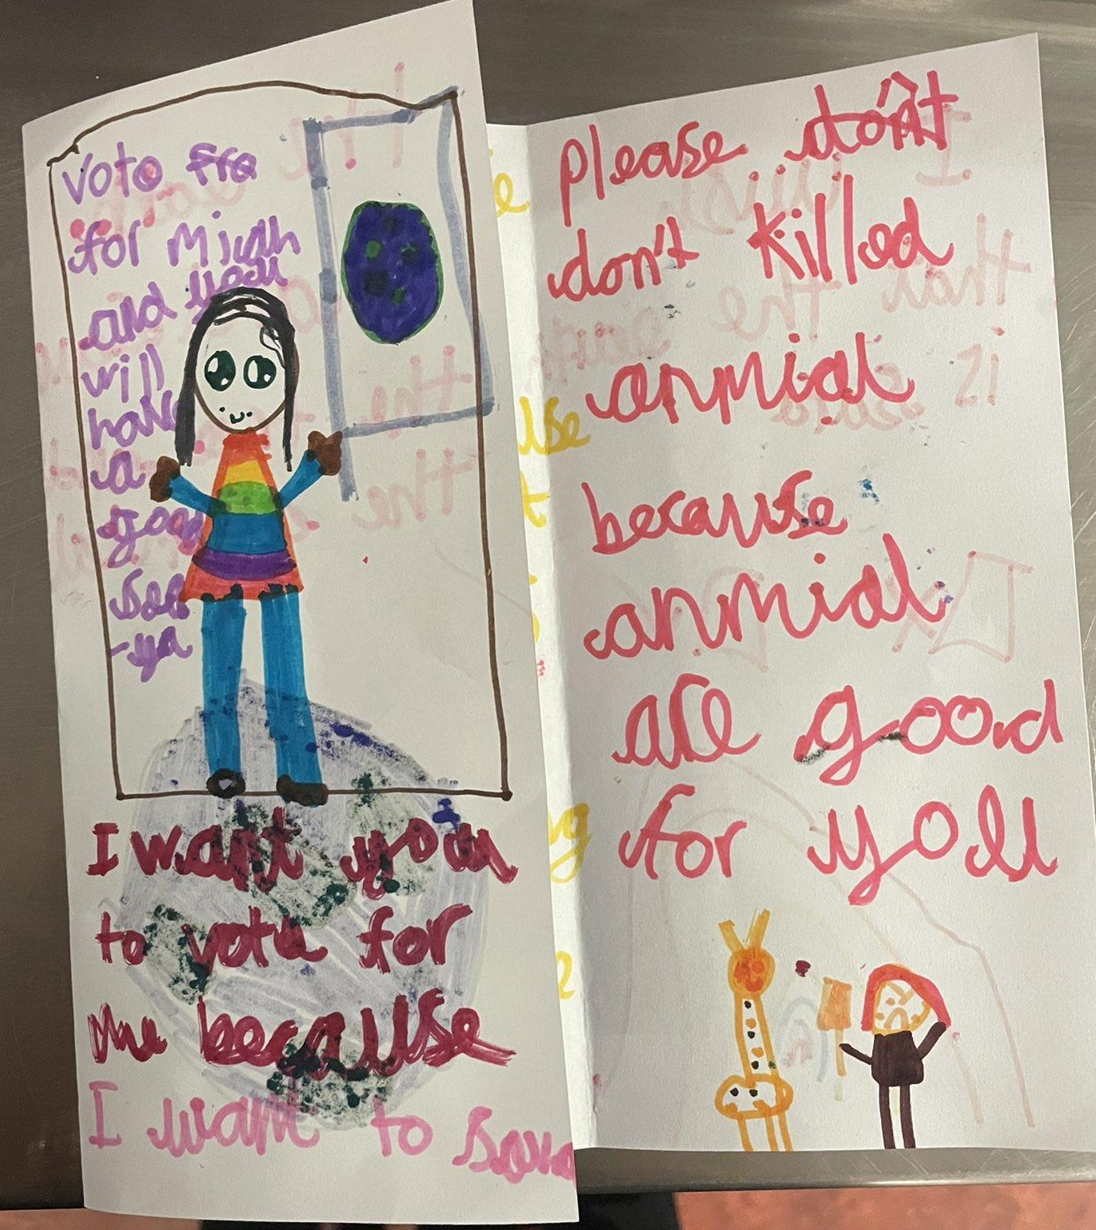
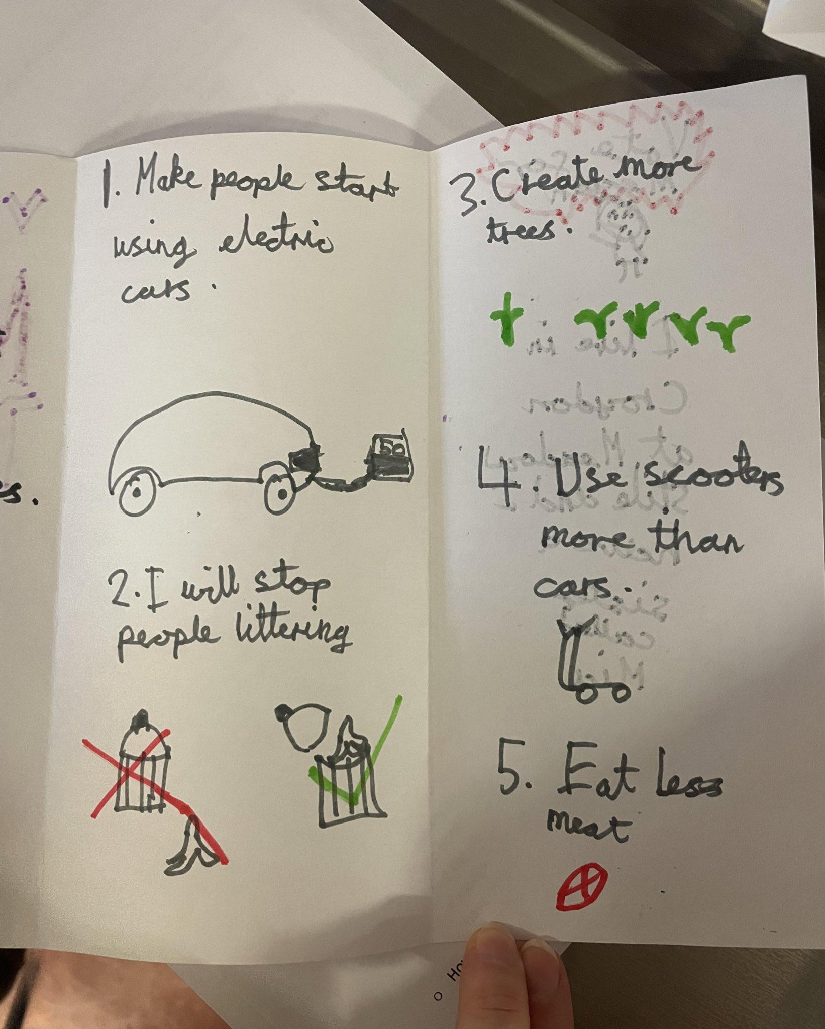

Slide 6
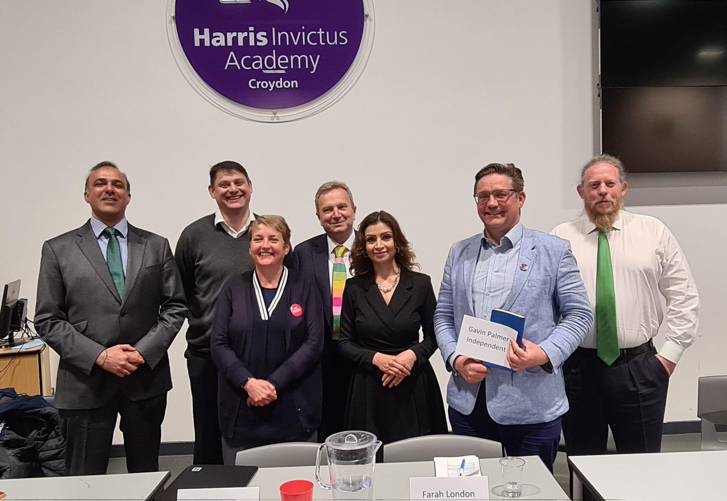
Croydon Mayoral Hustings and Election:Jason Perry, Conservative, elected Mayor and he has appointed Lynne Hale, Conservative, Deputy Mayor
What do the following tell us about his agenda for Croydon being carbon neutral by 2030 (a difference of wording from the CCCC Report- net zero Carbon emissions by 2030)
His Mayoral Pledge for Croydon to be carbon neutral by 2030 (tweet 15 March)
His responses to husting questions.
What action should Croydon Green Network take next in order to support Croydon Council and hold it to account on delivering the Mayoral Pledge that embodies the recommendations of the CCCC Report?
Notes:
Katherine can you explain how members can easily contact their councillors?

Slide 7
Great Big Green Week - 24 Sept -2nd October
THE GREAT BIG GREEN WEEK IS THE UK’S BIGGEST EVER CELEBRATION OF COMMUNITY ACTION TO TACKLE CLIMATE CHANGE AND PROTECT NATURE.
AND EVERYONE’S INVITED.
https://greatbiggreenweek.com

Slide 8
What activities/events could we organise?
We want to support activity/ events that:
In your application we ask that your event/ activity meets ONE of the following:
Empower local groups to create new connections locally that support new people and organisations to take climate action locally. E.g. local businesses, sports clubs, cultural organisations and faith groups
Led by or in partnership with groups who are underrepresented within the climate movement. E.g. ethnic minority, disability or economically deprived.
In locations with no existing green week or related activity. Or, where the event takes existing or previously funded activity to a new level.
Engage local politicians and/or councillors in events happening in their constituency.
Support engagement across generations and encourage intergenerational dialogue

Slide 9
We can bid for a medium grant £500-£5K by 30th June
GBGW can fund:
Equipment
One-off events
Staff costs (if directly supporting your Great Big Green Week Activity)
Transport
Utilities
Volunteer expenses
Publicity e.g flyers, social media advertising
GBGW cannot fund:
Alcohol, food & drink at your events
Contingency costs, loans, endowments or interest
Profit-making or fundraising activities
VAT you can reclaim
Overseas travel or projects that take place outside of the UK
Small land or refurbishment projects
Training costs
Your organisation’s running costs

Slide 10
Action:
Let us know your plans
If your events /activity needs funding please send outline and costings to:
croydonclimateaction@gmail.com by Monday 13th June
and we will endeavour to include in our bid to GBGW!

Slide 11
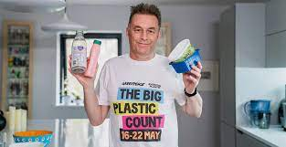
Upcoming Events
The Big Plastic Count
Count your plastic for one week – 16-22 May 2022.
Across the country, households of all shapes and sizes, schools, community groups and businesses, will gather new evidence. How much plastic are we really having to throw away, and what happens to it?
We’ll show the government it’s time to commit: reduce single plastic use by 50% by 2025 by switching to reusable options that work for everyone – and ban sending our waste to other countries.
Action: Sign up here: https://thebigplasticcount.com/sign-up
Notes:
Katherine can you explain how members can easily contact their councillors?

Slide 12
Upcoming Events
Croydon Green Spaces
https://www.worldenvironmentday.global
Would you like have a space to celebrate World Environment Day in Croydon Library?
Dawn Gibbons - Senior Library Assistant for Culture, Leisure & Libraries - has asked if Croydon Climate Action might want to have a display in the library on Level 1 to promote World Environment Day on Sunday 5th June. She says ‘We normally offer a group a 2 week display space but as we have the extended bank holiday leading up to the event it could be extended for a further week. A suggested date would be from Monday 23rd May to Friday 10th June.’
Action :
Email: Dawn.Gibbons@croydon.gov.uk

Slide 13
Upcoming Events
Sustainable Thornton Heath hub
Monthly event for sustainable living incl. Repair café, plant-based food tasting, workshops and more. 4th Saturday of the month - next one 28th May @ 1-4pm, Thornton Heath Salvation Army. No RSVP needed. Volunteers needed for CCA stall!
Friends of the Earth Groundswell Event Sat 25th June 10-5pm £10 tickets https://www.eventbrite.co.uk/e/groundswell-london-south-east-2022-tickets-290405569877 (let us know if you come as we will go together!)

Slide 14
Any Other Business (AOB)

Slide 15
Next meetup:
Wednesday 8th June 2022
18:30 - 19:30
We have a WhatsApp group – join using this link: https://chat.whatsapp.com/DlJKqszwLQb8aPagYzJ9qH

